Slide 1
Hartree-Fock study of the Anderson metal-insulator transition
in the presence of Coulomb interaction
Two types of mobility edges and their multifractal scaling exponents
2018.09.03
Hyun-Jung Lee
Seoul Science High School

Slide 2
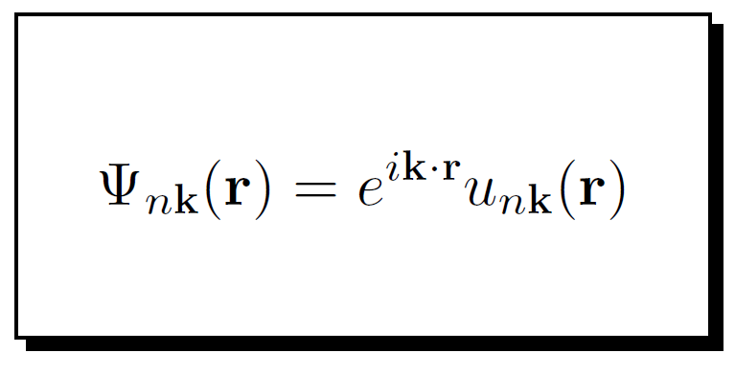
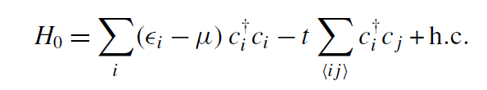
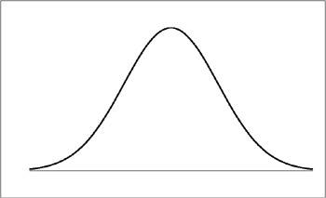
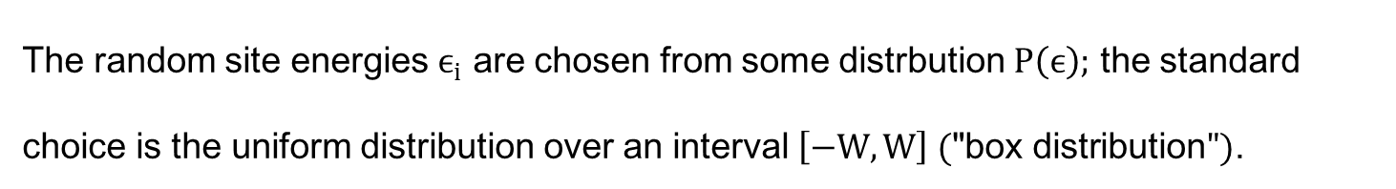


Anderson Transition
Anderson tight-binding model
The random site energies $ϵ_{i}$ are chosen from some distrbution $Ρ\left(ϵ\right);$ the standard choice is the uniform distribution over an interval $\left[−W,W\right] (\text{"}\text{box} \text{distribution}")$.
DOS
delocalized
localized
Order parameters?
$${−E}_{c}$$
$$E_{c}$$

Slide 3
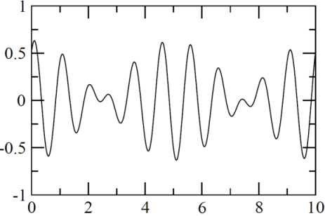
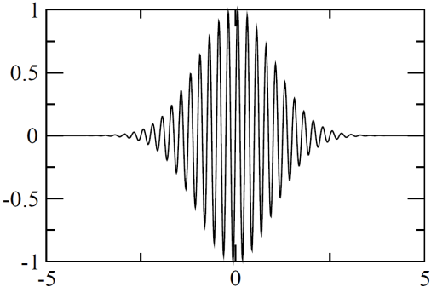

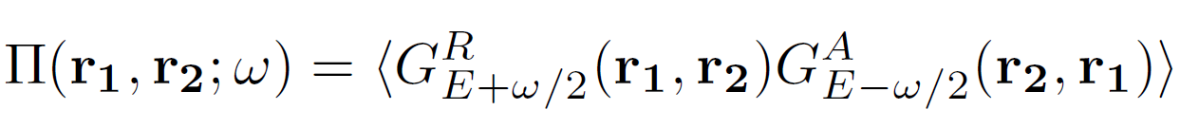
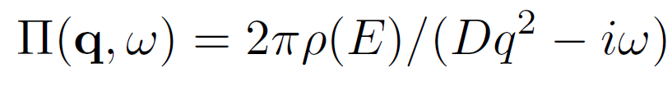
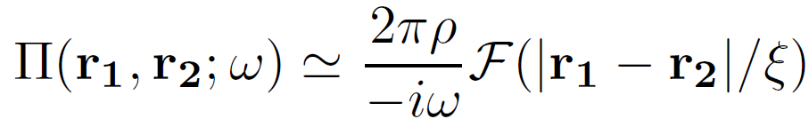

Anderson Transition
DOS
delocalized
localized
$${−E}_{c}$$
$$E_{c}$$
Delocalized
Localized
sample
sample
1
e-
2
e-
4
3
r
r
Diffusion propagator
delocalized
localized

Slide 4
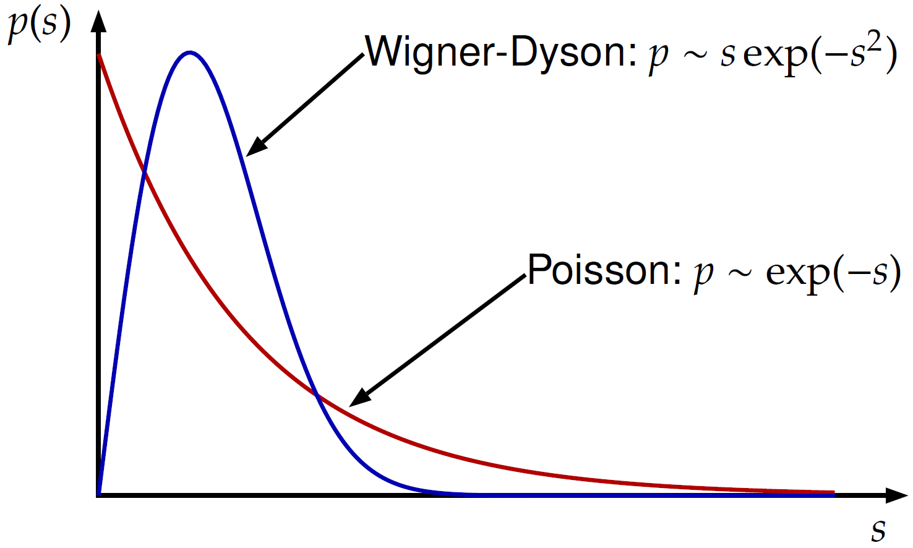

Spectral Statistics and Localization : Poisson .vs. Wigner-Dyson
Delocalized : Wigner-Dyson
Localized : Poisson
sample
sample
1
e-
2
e-
4
3
r
r
M. L. Mehta, Random Matrices, 2nd edition (Academic, San Diego, 1991).
$$s :level spacing$$

Slide 5
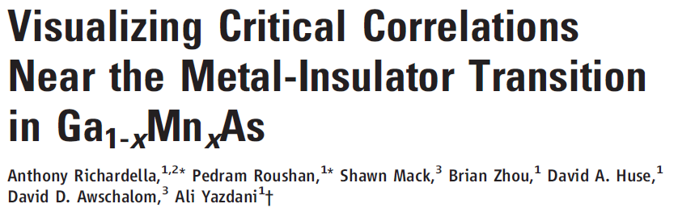
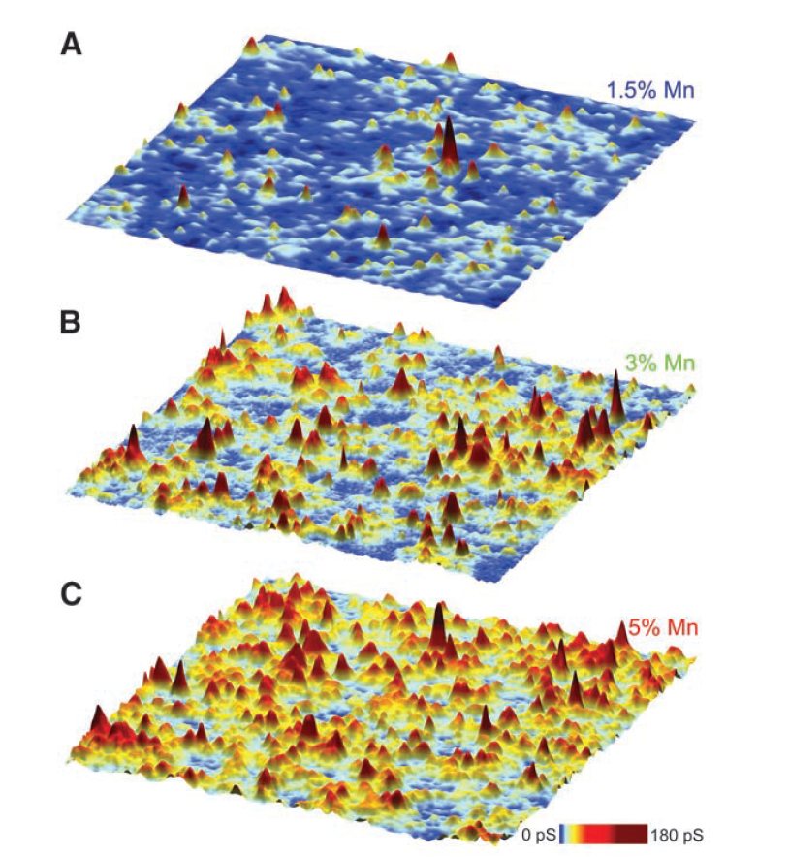
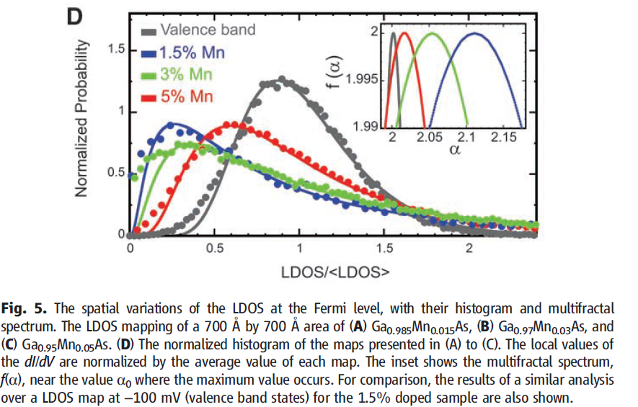
Metal-Insulator Transition in Diluted Magnetic Semiconductor
Spatial variations of the LDOS at the Fermi level

Slide 6
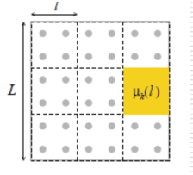
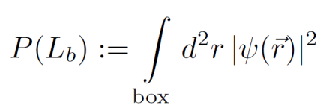
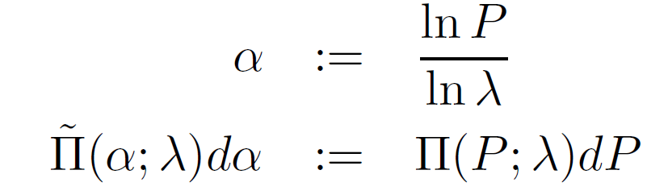

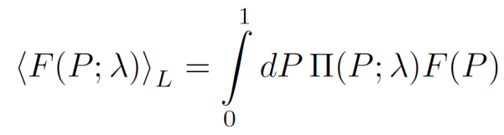
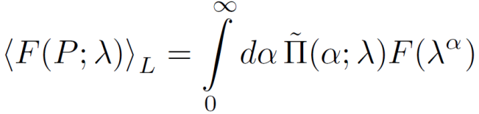






Probability distribution function :
$$Π(P;λ)$$
$$L_{b}$$
$$P\left(L_{b}\right)≔\int_{box}{d^{2}r {\left|ψ(\vec{r})\right|}^{2}}$$
$$P(L_{b})$$
$clean limit$
$P\left(L_{b};\overline{P,}σ_{P}\right)\sim λ^{d}$, $Π\left(P;λ\right)\sim exp\left\{−{\left(\frac{P−\overline{P}}{\sqrt{2}σ_{P}}\right)}^{2}\right\}$, $\tilde{Π}\left(α;λ\right)\sim δ(α−d)$
$dirty case$
$P\left(L_{b};\overline{P},σ_{α}\right)\sim λ^{α}$, $Π\left(P;λ\right)\sim exp\left\{−{\left(\frac{\ln{P}−\ln{\overline{P}}}{\sqrt{2}σ_{α}}\right)}^{2}\right\}$, $\tilde{Π}\left(α;λ\right)\sim exp\left\{−{\left(\frac{α−\overline{α}}{\sqrt{2}σ_{α}}\right)}^{2}\right\}$

Slide 7
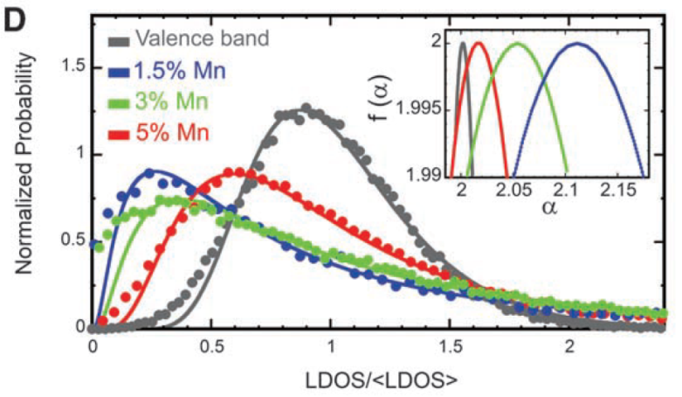

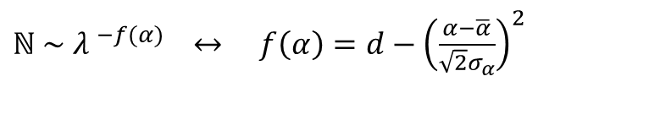
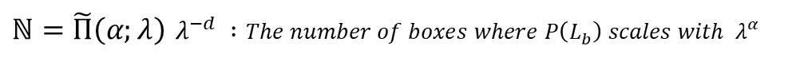
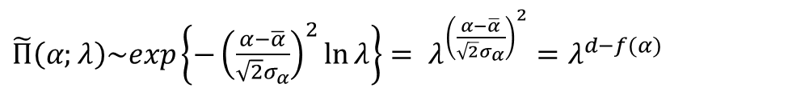
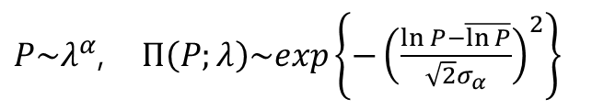
Singularity spectrum :
$$f(α)$$
$P\sim λ^{α}$, $Π\left(P;λ\right)\sim exp\left\{−{\left(\frac{\ln{P}−\overline{\ln{P}}}{\sqrt{2}σ_{α}}\right)}^{2}\right\}$
$\tilde{Π}\left(α;λ\right)\sim exp\left\{−{\left(\frac{α−\overline{α}}{\sqrt{2}σ_{α}}\right)}^{2}\ln{λ}\right\}= λ^{{\left(\frac{α−\overline{α}}{\sqrt{2}σ_{α}}\right)}^{2}}=λ^{d−f(α)}$
$ℕ=\tilde{Π}\left(α;λ\right)$ $λ^{−d} :The number of boxes where P\left(L_{b}\right) scales with{ λ}^{α}$
$ℕ \sim { λ }^{−f(α)}$ $↔ f\left(α\right)=d−{\left(\frac{α−\overline{α}}{\sqrt{2}σ_{α}}\right)}^{2}$

Slide 8
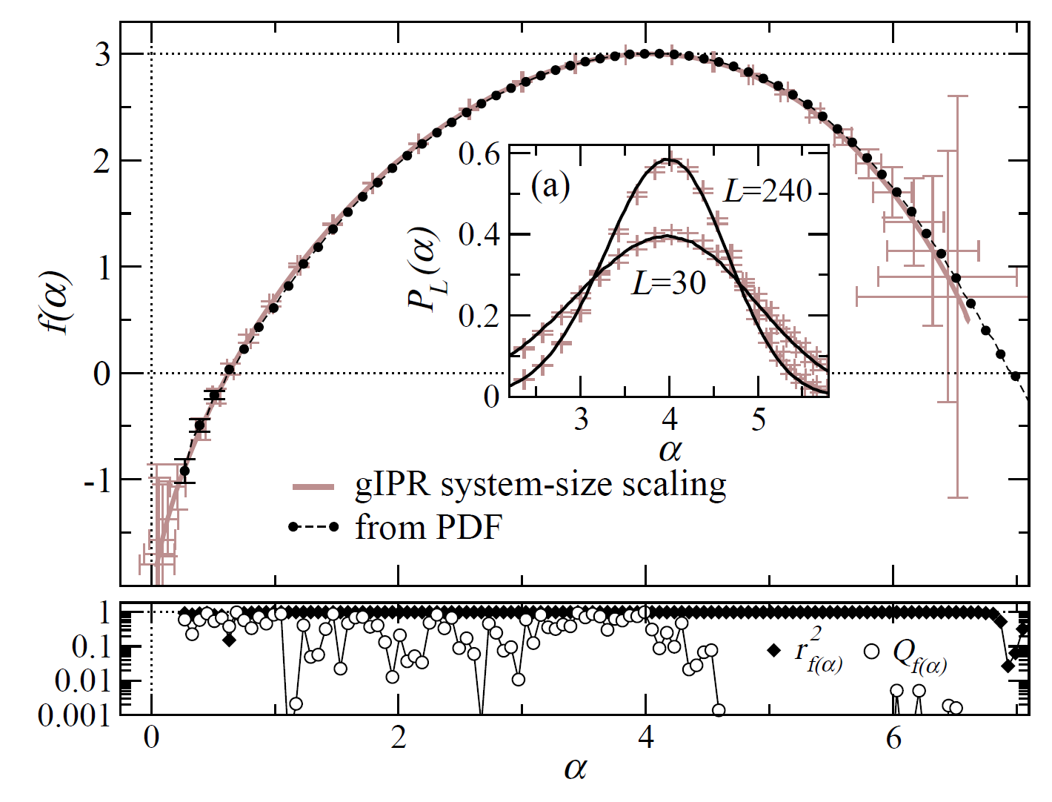
$$Multifractality→scale invariance of the distribution function Π(P;λ)$$
$$i.e. The values of f\left(α\right) and α are uniquely defined in the thermodynamic limit L→∞.$$
A. Rodriguez, L. J. Vasquez, R. A. Roemer, Phys. Rev. Lett. 102, 106406-4 (2009)

Slide 9
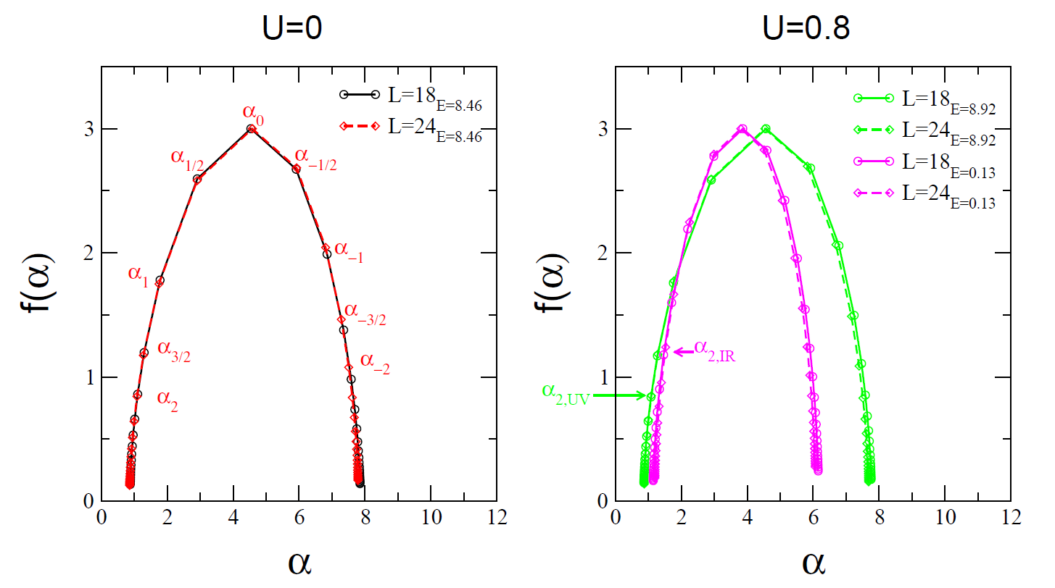
$$Multifractality→scale invariance of the distribution function Π(P;λ)$$
$$i.e. The values of f\left(α\right) and α are uniquely defined in the thermodynamic limit L→∞.$$
Hyun-Jung Lee and Ki-Seok Kim, Phys. Rev. B 97, 155105 (2018)
Typical averaged IPR of the 3D Anderson model

Slide 10
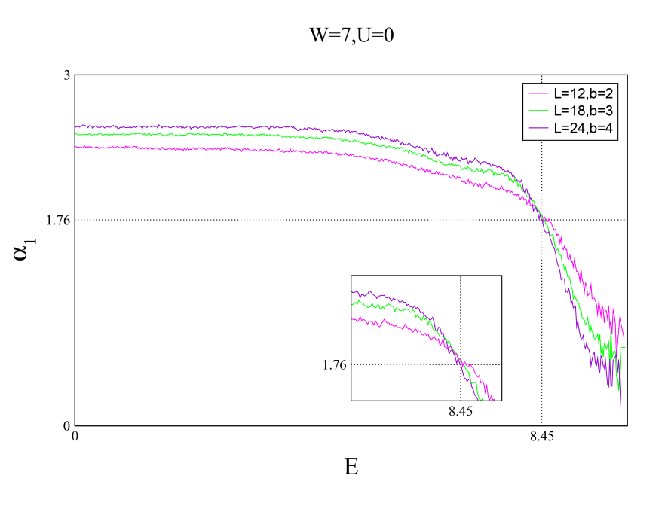
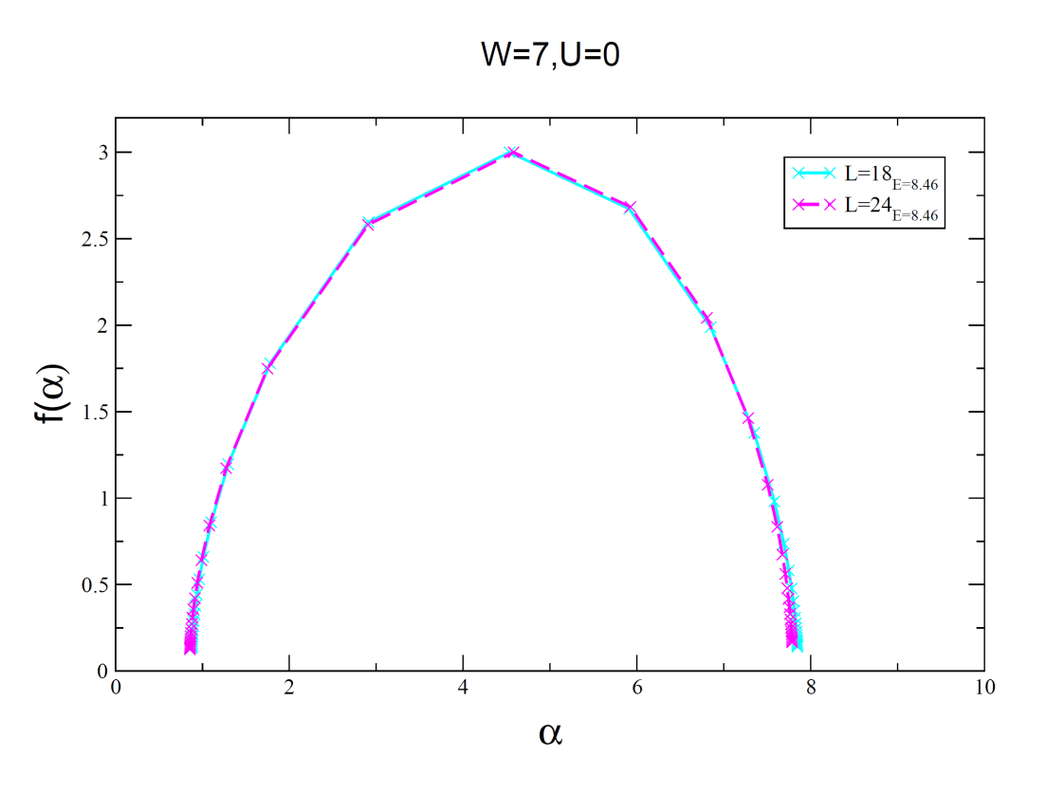






$$Mobility edge and the Multifractal scaling exponents$$
$$L_{b}=b$$
$$W=7, U=0, E=E_{c}$$
${(α}_{1}, f{(α}_{1}$))
delocalized
localized
Hyun-Jung Lee and Ki-Seok Kim, Phys. Rev. B 97, 155105 (2018)

Slide 11
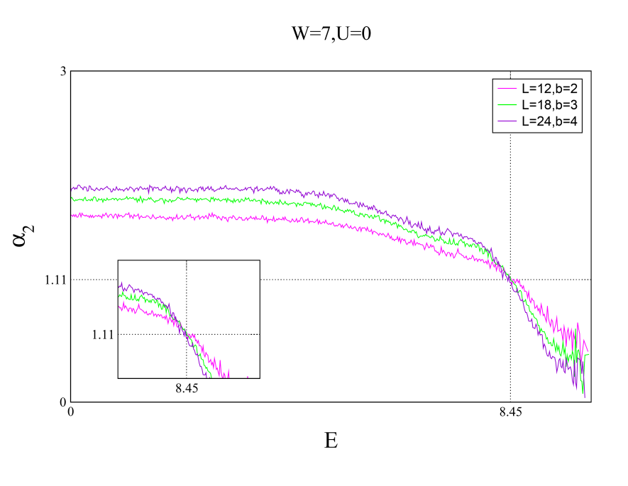



$$Mobility edge and the Multifractal scaling exponents$$
$$L_{b}=b$$
$$W=7, U=0, E=E_{c}$$
${(α}_{2}, f{(α}_{2}$))
delocalized
localized

Slide 12
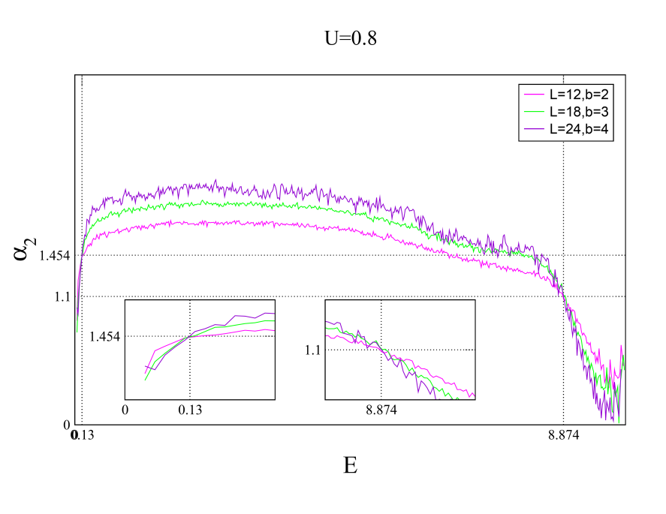
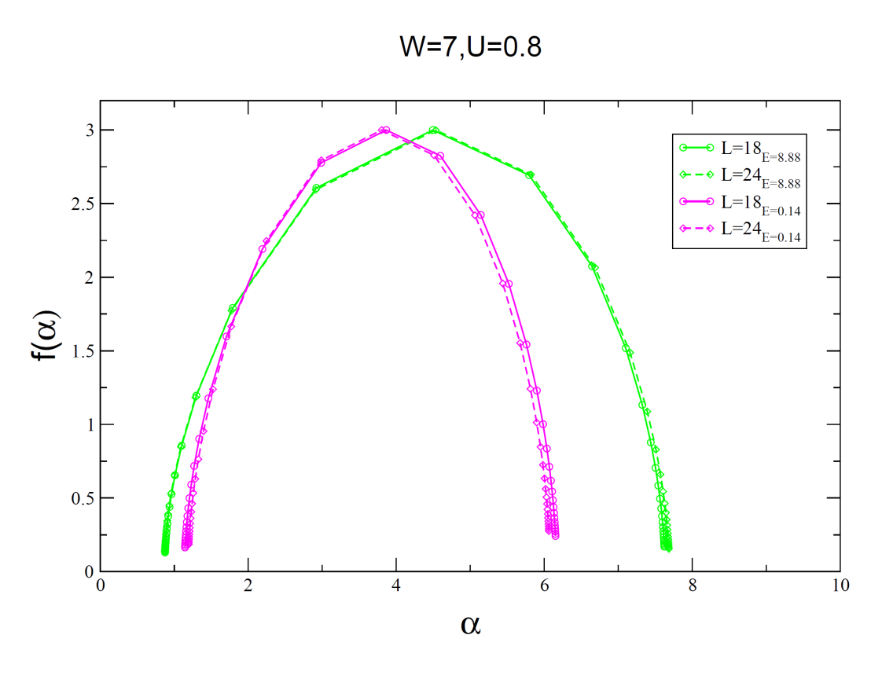
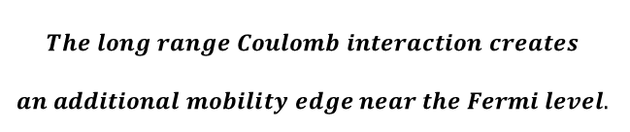







$$Two types of mobility edges and the Multifractal scaling exponents$$
$$( Interacting systems)$$
$$L_{b}=b$$
$$W=7, U=0.8, E=E_{c}$$
$${E=E}_{c2.}$$
$${E=E}_{c1.}$$
$$α_{2,c2.}=1.454$$
$$α_{1, c1}=1.1$$
localized
delocalized
localized
$$The long range Coulomb interaction creates$$
$$an additional mobility edge near the Fermi level.$$
Hyun-Jung Lee and Ki-Seok Kim, Phys. Rev. B 97, 155105 (2018)

Slide 13


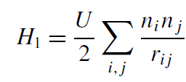
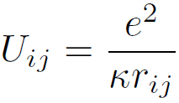
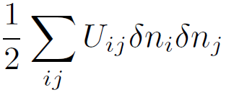


$$Anderson tight binding Hamiltonian with diagonal disorder$$
conduction band
t
t
t
t
μ
donor ions
Ionic potential → diagonal disorder
: random potential

Slide 14
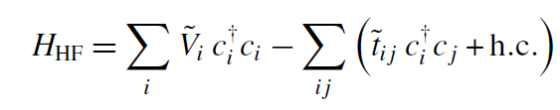
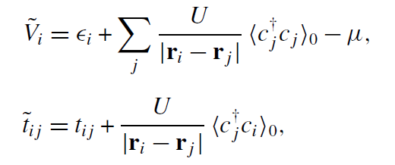
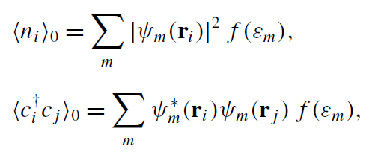
$$Anderson model with the long range Coulomb interaction$$
Hartree-Fock approx.
-K

Slide 15
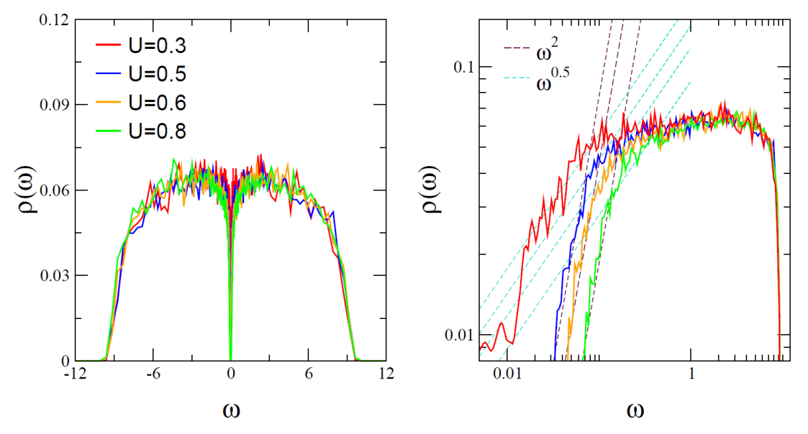
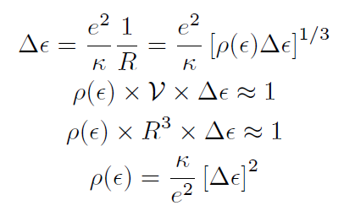




$$Efros−Shklovskii gap (U>U_{c})$$
Efros and Shklovskii, J. of Phys. C, Solid State phys. 8, L49 (1975)
Hyun-Jung Lee and Ki-Seok Kim, Phys. Rev. B 97, 155105 (2018)
M. Amin et al., New Journal of Physics 16 (2014) 015022 (2014)

Slide 16





Altshuler and Aronov effect$(U<U_{c})$
Altshuler and Aronov, Solid State Commun. 30 115 (1979)
Hyun-Jung Lee and Ki-Seok Kim, Phys. Rev. B 97, 155105 (2018)

Slide 17

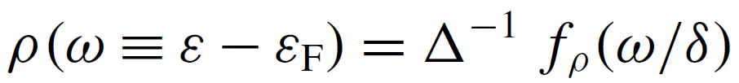




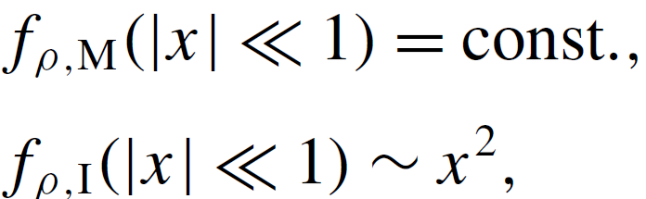

M$cMillan−Shklovskii scaling (U=U_{c})$
W. L. McMillan, Phys. Rev. B 24, 2739 (1981) ; M. Lee, J. G. Massey, V. L. Nguyen, B. I. Shklovskii, Phys. Rev. B 60, 1582 (1999)
π/2
Hyun-Jung Lee and Ki-Seok Kim, Phys. Rev. B 97, 155105 (2018)

Slide 18
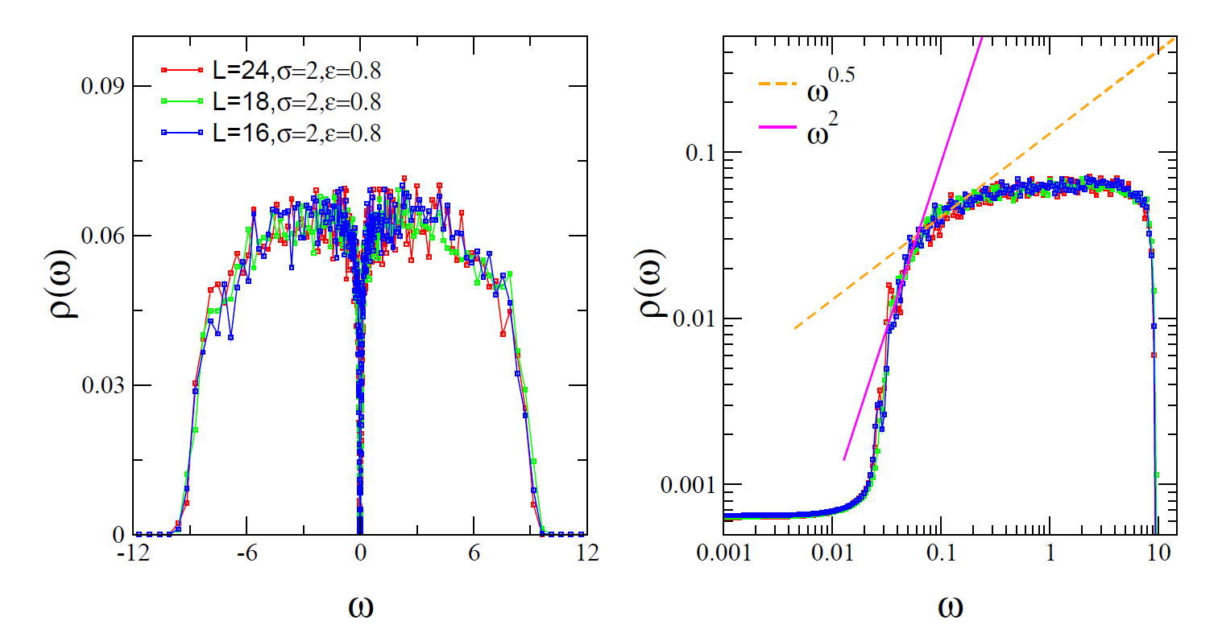
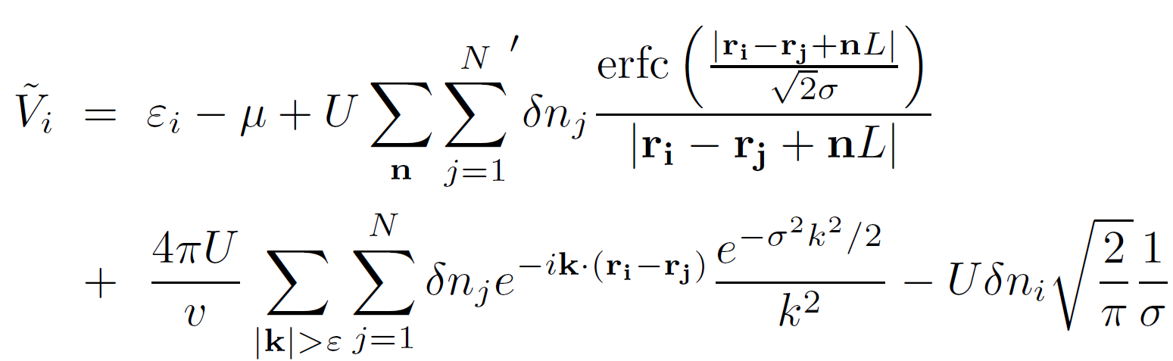
Ewald summation
Hyun-Jung Lee and Ki-Seok Kim, Phys. Rev. B 97, 155105 (2018)

Slide 19
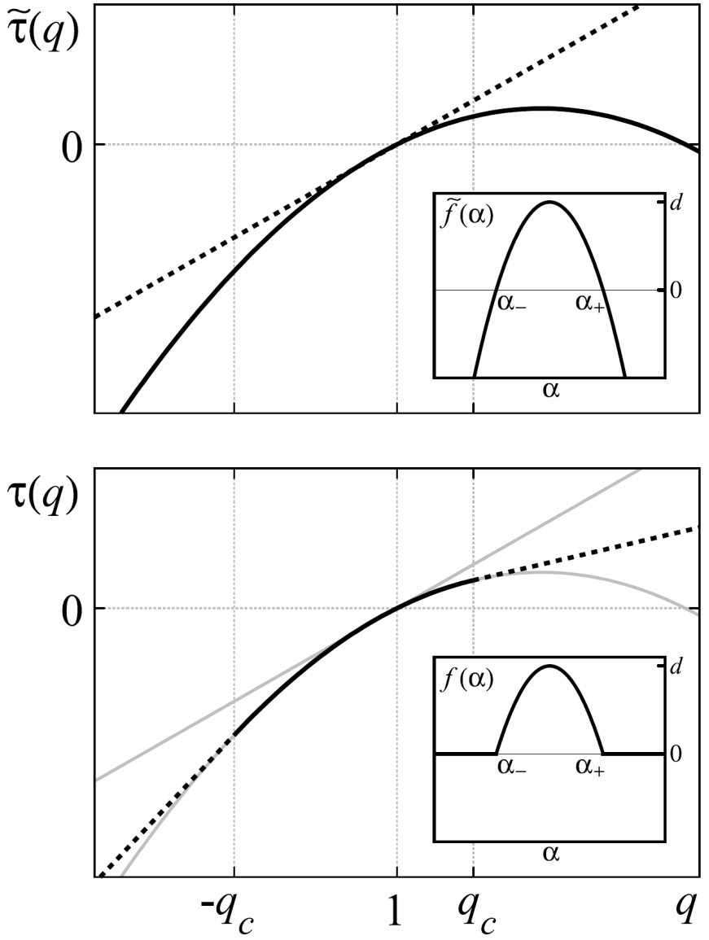
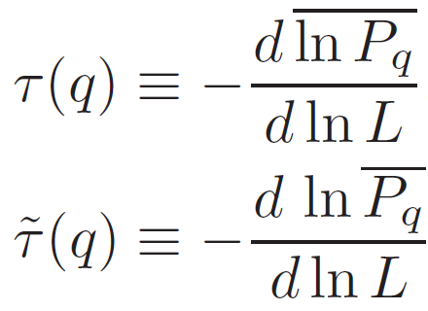
$$Termination of typical wavefunction multifractal spectra$$
Matthew S. Foster, Shinsei Ryu, and Andreas W. W. Ludwig, Phys. Rev. B 80, 075101 (2009)

Slide 20
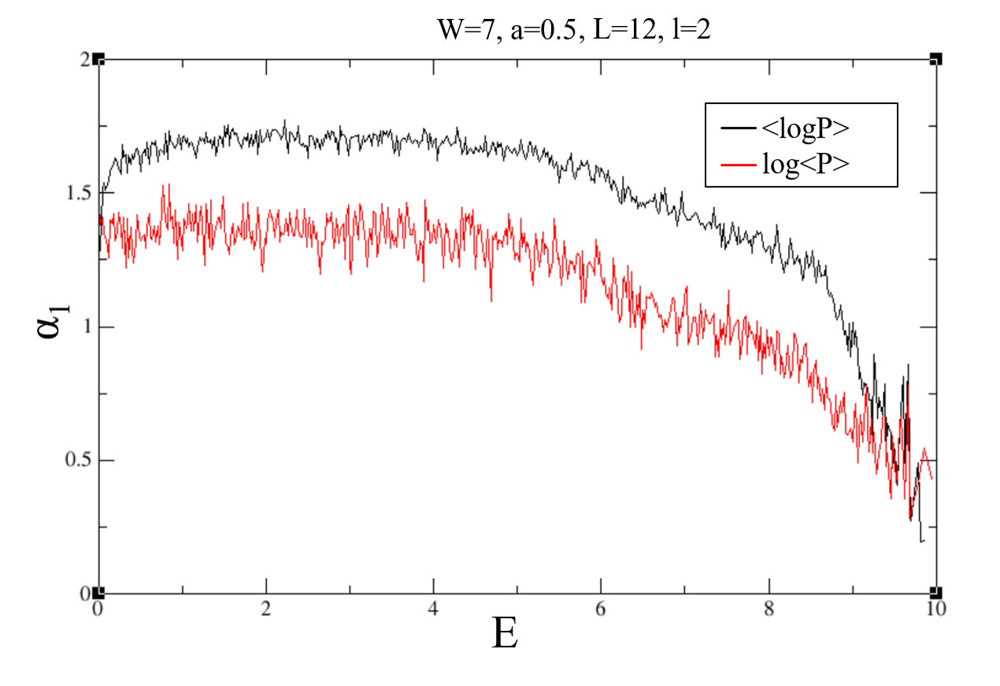
$$Typical .vs. quenched averaged inverse participation ratio$$

Slide 21
Summary
The interaction-driven localization transition is studied within a Hartree-Fock treatment of disordered, Coulomb-interacting spinless fermions.
  The localization transition is concomitant with the quantum to classcial crossover in the shape of the pseudo-gap in the tunneling density of states.
  A scaling analysis of wave-functions and inverse participation ratio is performed to demonstrate the multifractality at two separate mobility edges: the long-range Coulomb interaction induces an additional mobility edge around the Fermi level besides the one in the vicinity of the UV cut-off.

