Slide 1




Scanning gate imaging of quantum-Hall electronic, spin, and nuclear spin states
K. Hashimoto
Department of Physics, Tohoku University, Japan
Centre for Spintronics Research Network, Tohoku University, Japan
Corroborators: T. Tomimatsu (Tohoku Univ.), S. Taninaka (Tohoku Univ.),
S. Nomura (Tsukuba Univ.), Y. Hirayama (Tohoku Univ.),

Slide 2
Outline
1. Introduction
- Quantum Hall system including incompressible states, electron spin polarization, and current-induced nuclear spin polarization
- Scanning probe techniques
2. Scanning gate imaging of QH incompressible states
3. Scanning nuclear resonance imaging of nuclear spin polarization and electron spin polarization. KH et. al., Nat. Commun. 9, 2215 (2018).
4. Conclusion
Hyperfine coupled quantum Hall system
V_{x}
e
n
e
n
n
n
n
2DEG
e
Magnetic field, B
I_{sd}
Notes:
I will show results obtained by two different scanning probe tehniques.
First one is recent work:
Second one is recently published work :

Slide 3
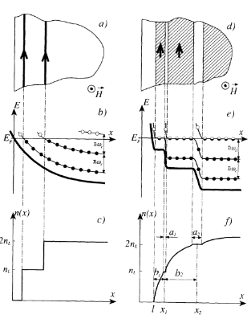
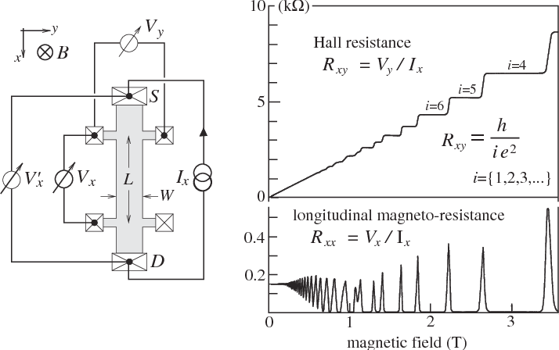

Topological boundary states in quantum Hall effect: edge states
IC
C
C
IC
C
Topological number
D. B. Chklovskii et. al., Phys. Rev. B 46, 4026 (1992).
Weis, J., & von Klitzing, K., Phil. Trans. R. Soc. A, 369, 3954 (2011).
Non- dissipative transport
( zero R_{xx} )
Edge states:
Compressible
Incompressible
=
Incompressible strip prevents backscattering between the chiral compressible channels
Y. Hatsugai, Phys. Rev. Lett. 71, 3697 (1993).
Boundary state in topological phases
Notes:
Under high B, kinetic energy of 2DEG is quantized and QHE arises as shown in the graph. Rxy shows plateau and Rxx shows 0 resistances at particular state integer LL filling factors. The QH states are one of the topological phase and integer number I included quantized Hall resistance indeed corresponds to topological number. When the topological phase has boundary such as QHS in the Hall bar, the boundary states so called edge states are formed. The edge state comprises alternate compressible and incompressible strips. Compressible phase is metallic and so potential slop is screened. On the other hads, incompressible phase is insulator, and so it can not screen the potential gradient and eventually quantized LL is tilted.
In particular incompressible strip plays an important role for non-dissipative transport observed as zero Rxx. incompressible strip which prevents backscattering between the chiral compressible edge channels.

Slide 4
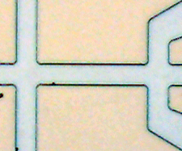
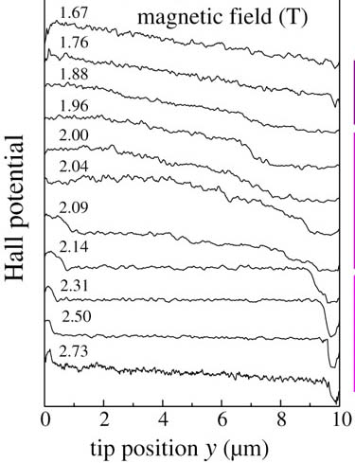
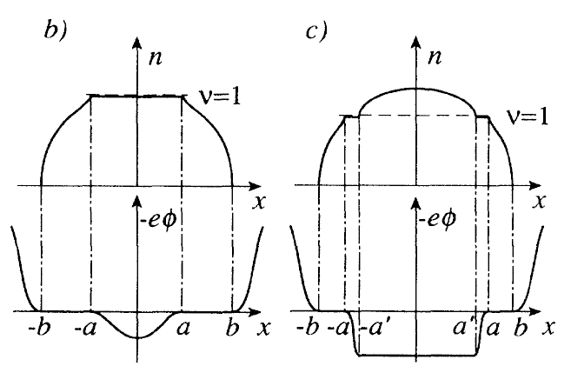
Local nuclear spins polarized at incompressible region
Hall potential mapping around integer filling (ν = 2)
Incompressible strip position in QH regime
x
D. B. Chklovskii et al., PRB47, 12605 (1993).
ν ~ 1.0
ν >1.0
Electron density
ν ~ 2.0
ν >2.0
Electrostatic potential
Bulk
Edge
Incompressible region
J. Weis and K. von Klitzing, Phil. Trans. R. Soc. A, 369, 3954 (2011)

Slide 5
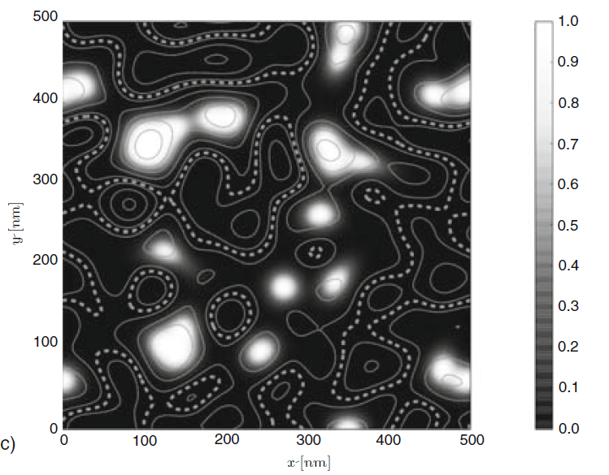
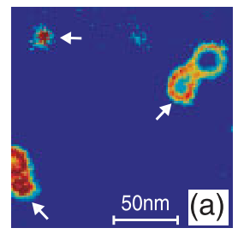
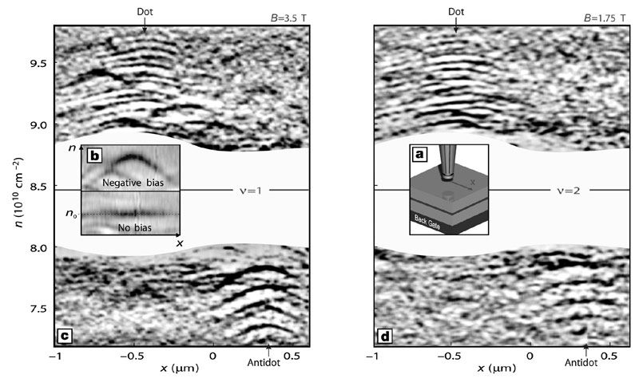
Bulk localized states in QHE
Compressible
Incompressible
n(x)
x (μm)
Sohrmann, C., Oswald, J. & Römer, R. A. “Quantum and Semi-classical percolation and Breakdown in Disordered Solids”, 762, 163 (2009).
KH., R.A. Römer, et. al., Physical Review Letters, 101, 256802 (2008)
S. Ilani et. al., Nature 427, 328 (2004).

Slide 6
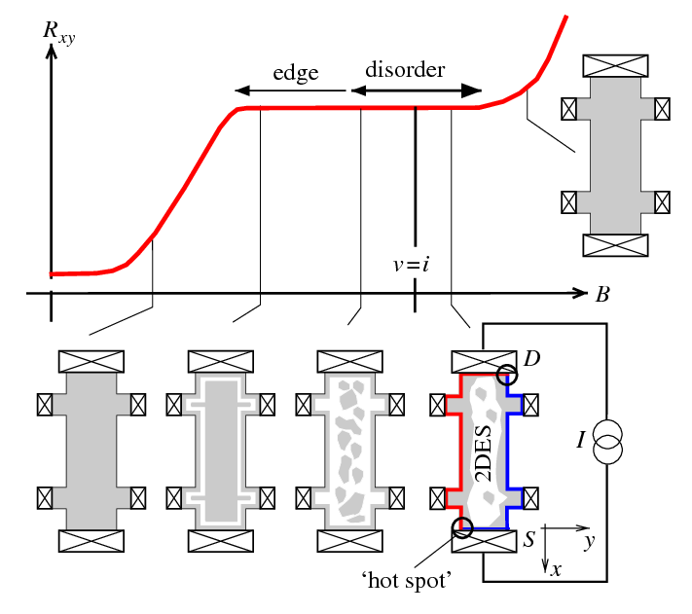
Microscopic nature of QHE: Evolution of incompressible states from edge to bulk states
ν
Weis, J., & von Klitzing, K., Phil. Trans. R. Soc. A, 369, 3954 (2011).
The comprehensive evolution of incompressible phase have not been experimentally demonstrated yet.
Notes:
The schematic shows expecting evolution from edge incompressible strip to bulk localized states.
But such a comprehensive evolution of incompressible phase have not been experimentally demonstrated yet.

Slide 7
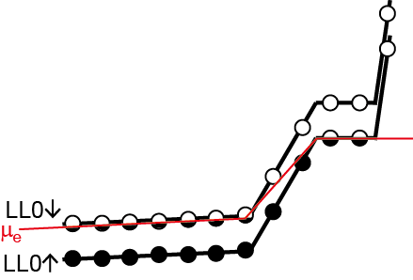

Dynamic nuclear polarization (DNP) induced in incompressible strip
Hyperfine Hamiltonian
$$ℋ_{HF}∝\frac{A_{H}}{2}\left(I^{+}S^{−}+{I^{−}S}^{+}\right)+A_{H}I_{z}S_{z}$$
Spin flip-flop
Overhauser effect
Flip-flop process
Electron
spin
Nuclear
spin
Inter LL scattering
LL0
μ_{e}
Odd filling factor
LL0
C
IC
C
Non-uniform nuclear spin polarization
Detection of nuclear spin polarization
Notes:
One more interesting role of the incompressible state is to provide a place for hyperfine coupling. Near odd filling factor, the Fermi level locates in between spin un and down LL. Due to inter LL scattering, electron spin flips and the spin is transferred to nuclear spin, consequently induces non uniform nuclear spin polarization near the incompressible region

Slide 8
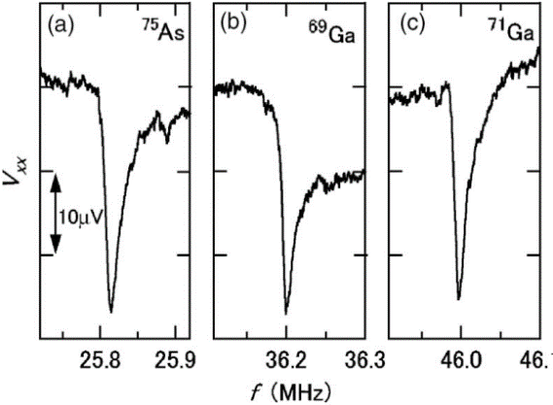
Resistively detected NMR
Resistively-detected NMR in QH breakdown
I_{sd}
V_{x}
Current-induced dynamic nuclear polarization
Resistive detection of nuclear polarization
Kawamura et al. APL 90, 022102 (2007).
Notes:
When a strong magnetic field is applied to 2D electron gas, so called quantum Hall effect emerges.
Such QH systems comprise wide variety of electronic spin states that often couple with nuclear spins of host material through hyperfine interaction

Slide 9
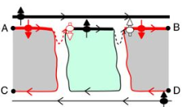

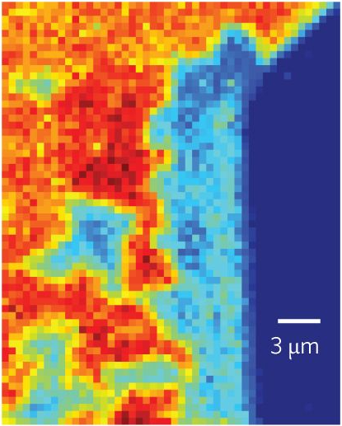
Non-uniform spin polarization
Nuclear spin
Current induced dynamic nuclear polarization in QH breakdown and QH ferromagnet
Yang et. al., Nat. Comm. 8, 1 (2017).
Moore et. al., Phys. Rev. Lett. 118, 076802 (2017).(optical detection)
Electron spin
Wigner crystals near ν = 2
Tiemann et. al., Nat. Phys. 10, 648 (2014).
QH strip phase
Friess et. al., Phys. Rev. Lett. 113, 076803 (2014).
Spin domains at ν = 2/3 (optical detection)
Hayakawa et. al., Nat. Nanotech., 8, 31 (2013).
Spatial distribution of nuclear/electron spin polarization plays a crucial role.
Notes:
Recently detailed resistive detected NR have suggested crucial characteristics of non-uniform distributions, including those of the current-induced DNP in the QH ferromagnet and electron spin polarization
The optical measurement involves the influence of photo-excited carriers and a limited spatial resolution

Slide 10

Scanning gate imaging
V_{x}
2DEG
M. Topinka, R. Wester-velt et al, Science289, 2323 (2000).
Magnetic field, B
I_{sd}
Scanning gate imaging
Scanning nuclear spin resonance imaging
Evolution of incompressible states from edge to bulk states
Spatial distribution of
dynamic nuclear spin polarization
QH electronic spin polarization
n
e
e
n
n
n
e
n
Notes:
To probe electronic states, and nuclear/electron spin polarization, we used scanning gate imaging technique which was originally developed by Wester-velt group. Appling the technique we developed new two different techniques. First one is

Slide 11
Sample
Local gate
~ 1 nm
Backgated 20 nm quantum well
(μ ~ 120 m²/Vs）
Cap layer (Si-GaAs)
Si δ-doped AlGaAs layers
165 nm
Hall bars; 10 μm width
AlGaAs
20 nm
GaAs QW
Buffer layers
(AlAs/GaAs super lattice)
e
e
e
n
n
n
n
n
Back gate
(Si doped GaAs)
Supplied by K. Muraki (NTT BRL)
Notes:
We fabricated the 10μm-wide Hall bar samples from this wafer

Slide 12
Scanning gate imaging
V_{x}
2DEG
M. Topinka, R. Wester-velt et al, Science289, 2323 (2000).
Magnetic field, B
I_{sd}
Scanning gate imaging
Scanning nuclear spin resonance imaging
Evolution of incompressible states from edge to bulk states
Spatial distribution of
dynamic nuclear spin polarization
QH electronic spin polarization
n
e
e
n
n
n
e
n

Slide 13
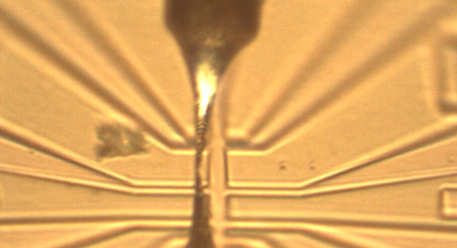
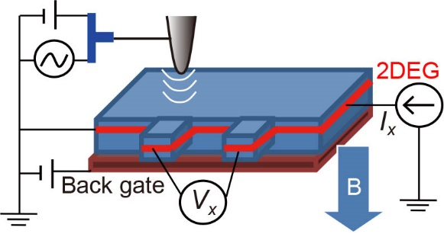
Scanning-gate imaging incorporated non- equilibrium transport
Inter LL scattering
I_{sd}
LL0
μ_{e}
C
IC
C
LL0
Small DC voltage (0.2V) not to perturb global electron density (filling factor).
Constant DC I_{sd} (~ a few μA) to induce non-equilibrium transport.
Resistive detection .

Slide 14
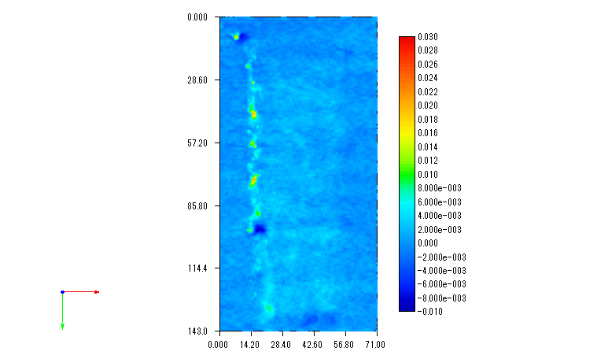
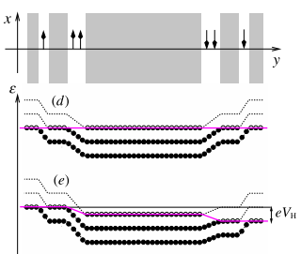
Scanning-gate imaging incorporated with non- equilibrium transport
ν = 2.27
ΔVx (μV)
B=4T
4 μm
60
I_{sd} =3.1 μA
R_{xx} (kΩ)
B
ν
V_{x} - I_{sd}
I_{sd}
0
Hall bar
ν = 2.27
-20
Inter LL scattering
V_{x} (mV)
Weis, J., & von Klitzing, K., Phil. Trans. R. Soc. A, 369, 3954 (2011).
Innermost incompressible strip
In higher chemical potential side
I_{sd} (μA)
Notes:
We attribute the line pattern to innermost incompressible strip in higher chemical potential side.

Slide 15
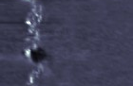
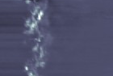
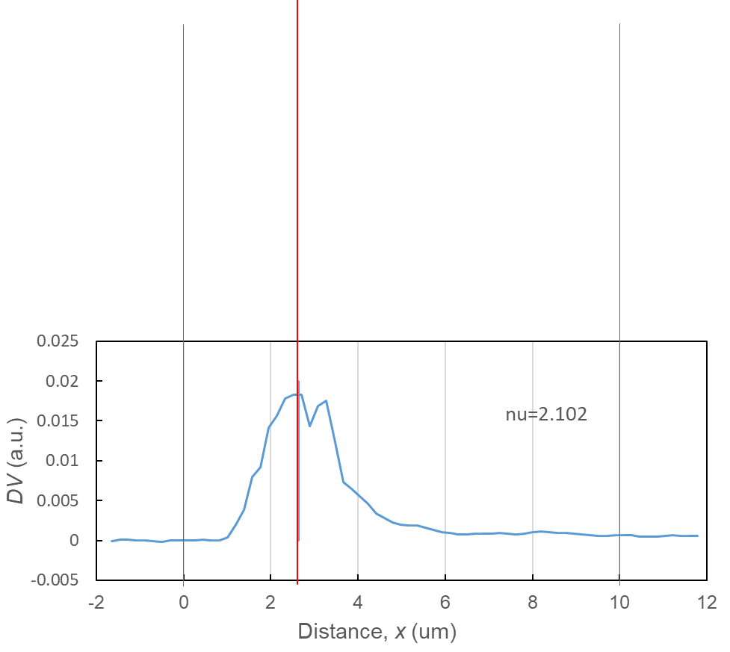
Incompressilbe strips at ν ∼ 2
3 μm
B = 4 T
ν ~ 2 B = 4 T
0.017
0.056
2.17
2.4
2.32
2.3
2.22
0
0
2.2
n (1/m²)×10¹⁵
0.039
0.094
ν
2.13
2.13
2.1
2.03
0
0
2.0
1.93
0.067
0.0
1.0
2.0
3.0
4.0
5.0
edge
y (μm)
center
0.125
ν _{L} = 2 incompressible region calculated by Local spin density approximation
0
0
2.10
2.10
Calculated by Nomura (Tsukuba Univ.)
Good agreement with region of QH incompressible strip calculated by LSDA calculation.
FWHM
Measured by Tomimatsu (Tohoku Univ.)

Slide 16
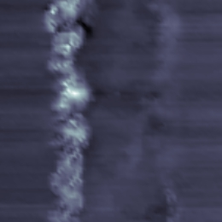
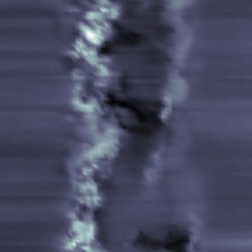
Incompressilbe strips of ν ∼ 1
ν ~ 1 B = 8 T
3 μm
1.20
2.32
1.090
1.015
1.15
2.22
ν
1.10
n (1/m²)×10¹⁵
2.13
ν _{L} = 1
1.05
2.03
1.040
1.008
1.00
1.93
0.0
1.0
2.0
3.0
4.0
5.0
y (μm)
1.022
Measured by Tomimatsu (Tohoku Univ.)
Calculated by Nomura (Tsukuba Univ.)

Slide 17
Evolution from edge strip to Localized bulk state
ν ~ 1 B = 6 T
ν =1.05
ν =1.01
ν =1.00
3 μm
Closed loop patterns
n(x)
Measured by Taninaka (Tohoku Univ.)
Localized states: Compressible paddles encircled by incompressible region
x (μm)
Notes:
To clarify the evolution of incompressible strip, we did mapping in wider region. We attribute the pattern to the localized states. We infer that there are the potential minima at positions marked by crosses, and therefore the additional electron acuminate and create compressible paddle which is encircled by incompressible region. These results clearly demonstrate the evolution of incompressible phase from

Slide 18
Scanning gate imaging
V_{x}
2DEG
M. Topinka, R. Wester-velt et al, Science289, 2323 (2000).
Magnetic field, B
I_{sd}
Scanning gate imaging
Scanning nuclear spin resonance imaging
Evolution of incompressible states from edge to bulk states
Spatial distribution of
dynamic nuclear spin polarization
QH electronic spin polarization
n
e
e
n
n
n
e
n

Slide 19
Non-uniform dynamic nuclear spin polarization
Isd
ν ~ 1 (B = 7-8 T)
B
Non-uniform DNP
Flip-flop process
Electron
spin
Nuclear
spin
LL0
μ_{e}
LL0
C
IC
C
Notes:
We used almost same condition as the SGM measurements shown in first part
Schematic shows our setup
To induce DNP and detect nuclear polarization, I used QH breakdown as a model system . The breakdown region is marked in IV curve where resistance abruptly increases

Slide 20
Scanning-gate imaging incorporated with nuclear spin resonance
I_{sd}
RF electric field applied by the scanning probe.
Constant DC I_{sd} (~ a few μA) to induce dynamic nuclear polarization (DNP).
Resistive detection .

Slide 21
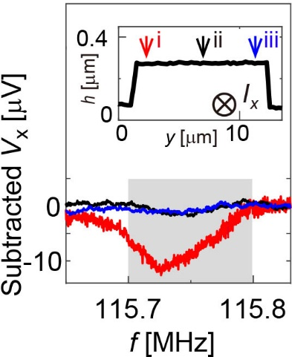
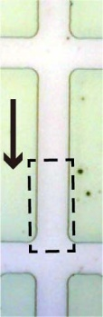
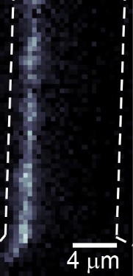

Intensity mapping at ν = 1.10
H
L
Electron
B = 7T
Local spectra for ⁷⁵As nuclear resonance

Slide 22
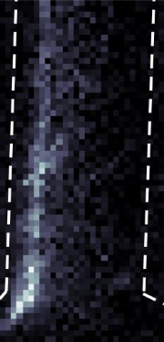
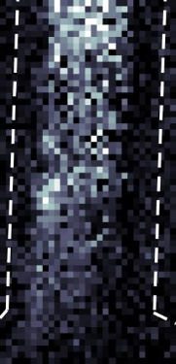
Filling factor dependence of non-uniform dynamic nuclear polarization
ν = 1.10
ν = 1.05
ν = 1.00
Visualizing of non-uniform dynamic nuclear polarization
Incompressible state
KH et. al., Nat. Commun. 9, 2215 (2018).

Slide 23
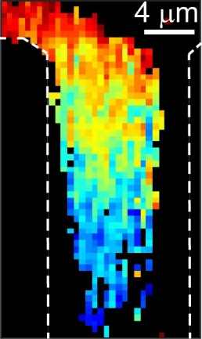
Knight-shift image
Spatial variation of electron depolarization
During the electrons drift, the excitation from spin up to down states is accelerated by electron heating
Pe
86%
70
ν = 1 breakdown
60
Electron drift
50
57%
ΔKs~23kHz
ΔPe=26%
y
Komiyama et al. PRL 77, 558 (1996). Kawamura et al. APL 90, 022102 (2007).
KH et. al., Nat. Commun. 9, 2215 (2018).
Notes:
This trend is strikingly obvious on the Ks image. The observed spatial variation of electron depolarization can be explained by a reduction in the population in the lowest LL0 spin up state due to the excitation of a nonequilibrium electron from LL0up to LL0down.

Slide 24
Conclusions
Scanning gate techniques
Evolution of incompressible states
Distribution of DNP and electron spin polarization
Microscopic characteristics of QH system/QH-breakdown system.
Perspectives: Incompressible states in fractional QH system, quantum point contact (QPC)
Various hyperfine-coupled systems: QH Skyrmion, Chiral QH edge states, QPC (0.7 anomaly), ¹³C nanotube, topological surface states.
Notes:
highlight the ability of our technique to reveal the microscopic aspects of electron/nuclear spin polarisation. This powerful technique can be utilized for direct microscopic examination of various hyperfine coupled quantum systems, e.g. integer and fractional QH ferromagnets where Skyrmions and the electronic spin domains emerge, the 0.7 anomaly in the quasi-1D system such as in quantum point contacts , and the helical nuclear magnetism theoretically predicted in 1D conductors, including 13C nanotubes

Slide 25
Incompressilbe strips of ν ∼ 2 and 4
ν ~ 2 B = 4 T
ν ~ 4 B = 2 T
0.056
0.017
3 μm
0
2.17
0
4.43
0.039
0.094
0
0
0.067
0.125
2.13
4.26
0
0
2.10
4.15
Measured by Tomimatsu (Tohoku Univ.)

Slide 26
Evolution from edge to bulk
Calculated by Nomura (Tsukuba Univ.)
ν ~ 2 B = 4 T
2.4
2.32
2.3
2.22
2.2
ν _{L} = 2
n (1/m²)×10¹⁵
ν
2.13
2.10
2.1
2.03
ν ~ 4 B = 2 T
2.0
1.93
4.8
2.32
0.0
1.0
2.0
3.0
4.0
5.0
FWHM
edge
y (μm)
center
ν _{L} = 4
4.6
2.22
4.4
n (1/m²)×10¹⁵
ν
2.13
Distance form edge: Y
4.2
2.03
4.0
1.93
0.0
1.0
2.0
3.0
4.0
5.0
y (μm)
Good agreement with region of QH incompressible strip calculated by LSDA calculation.

Slide 27
Comparison with local spin density approximation (LSDA) calculation
LSDA calculation including Hartree and exchange energy terms without imposed current.
Calculated by Nomura (Tsukuba Univ.)
S. Mamyouda et.al., Nano Letters, 15, 2417 (2015).
ν ~ 2 B = 4 T
IC strip
2.4
2.32
2.3
2.22
2.2
ν _{L} = 2
n (1/m²)×10¹⁵
ν
2.13
ν _{local}
B = 4 T
ν = 2.09
2.1
2.03
ν ~ 4 B = 2 T
2.0
1.93
4.8
2.32
0.0
1.0
2.0
3.0
4.0
5.0
edge
y (μm)
center
ν _{L} = 4
4.6
2.22
C strip
C strip
4.4
n (1/m²)×10¹⁵
ν
2.13
4.2
2.03
E_{F}
4.0
1.93
0.0
1.0
2.0
3.0
4.0
5.0
y (μm)
B = 4 T
ν = 2.09
Good agreement with region of QH incompressible strip calculated by LSDA calculation.
Distance from edge (μm)
Notes:
We found experimental results agree with region of QH ….. We concludes observed SGM pattern is QH incompressible pahse.

Slide 28
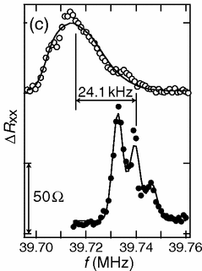
Resistively-detected Knight shift measurement
e
e
n
LL0
e
QH ferromagnet at ν = 1 and 2/3
Piot et. al., Phys. Rev. Lett., 116, 106801 (2016).
Stern et. al., Phys. Rev. B 70, 075318 (2004).
ν = 5/2 quantum fluid
Tiemann et. al., Science 335, 828 (2012).
Canted antiferromagnet in the bilayer ν = 2
Kumada et. al., Phys. Rev. Lett., 99, 076805 (2007).
Kumada et al. , PRL 99, 076805 (2007).
Knight shift
∝ electron spin polarization
Notes:
For instance, in QH electrons are fully polarized at nu =1. Knight field shifts nuclear resonance spectrum peak to
Detail RD NR spectroscopic measurements highlighted crucial characteristics of non uniform spin polarization
Fundamental frequency of host nuclei

Slide 29
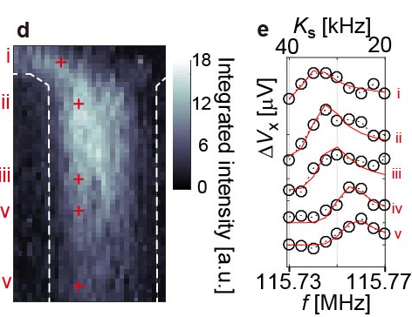
Knight shift in NR spectra at I_{sd} = 2.6 uA
Local NR spectra
NR intensity image at ν =1.02
80
40
Pe
80%
Electron drift
60%
KH et. al., Nat. Commun. 9, 2215 (2018).
Notes:
Next we address microscopic observation of electron spin polarization by mapping Knight shift.
Pe reduced as electron drifts from top to bottom by a distance of 30 micro
Figure 2e depicts the representative spectra (circles) with the fitting curves (red curve) at spatial points marked by crosses along the expected path of electron drift within the bulk-dominant pattern observed in the intensity image. The spectrum peak shift, from 115.74 MHz up to 115.76MHz between point ‘i’ on the electron injection side (the upper-left voltage probe) and point ‘v’on the lower side of the Hall bar, demonstrates that Ks spatially decreases from 71 KHz to 55kHz. This trend is strikingly obvious on the Ks image (Fig. 2c), indicating spatial reduction in electron spin polarisation

Slide 30
Impact of current on spatial variation of electron polarization
90
Electron drift
70
50
Full spin polarization
90
70
Spatial variation is suppressed near the critical current of QH breakdown
50
x’ [um]
KH et. al., Nat. Commun. 9, 2215 (2018).
Notes:
It is obvious in cross sectional carves along the path of electron drift.

Slide 31

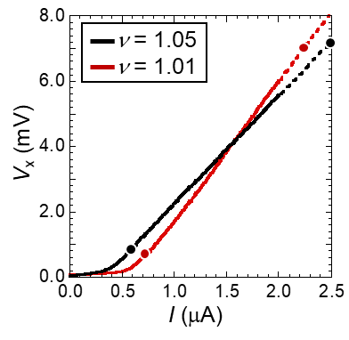
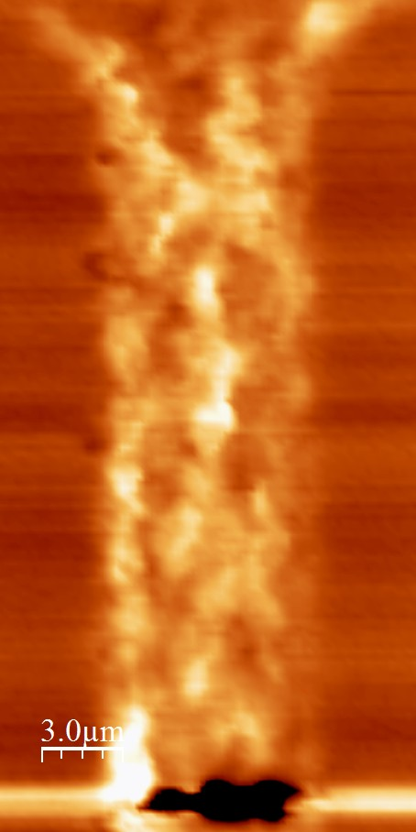
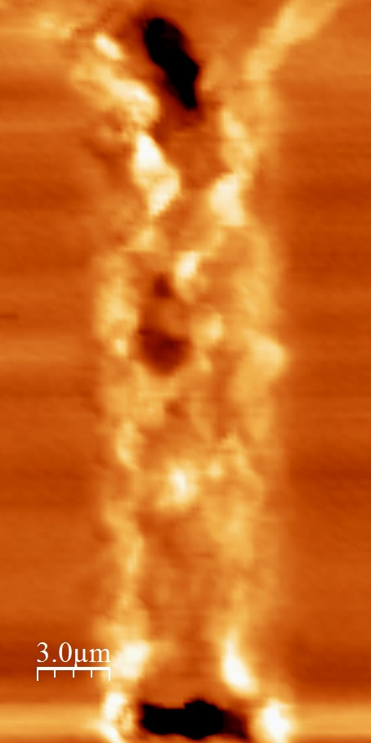
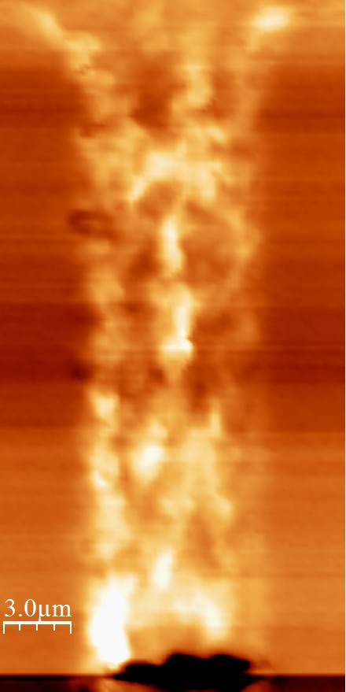
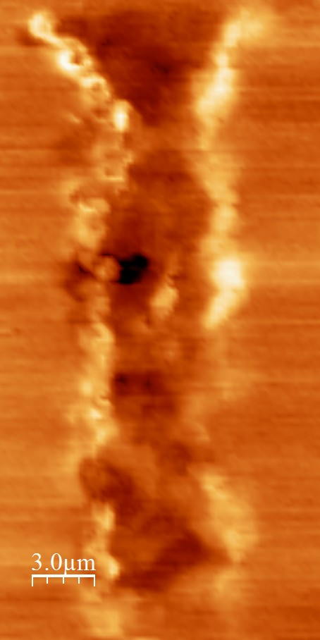
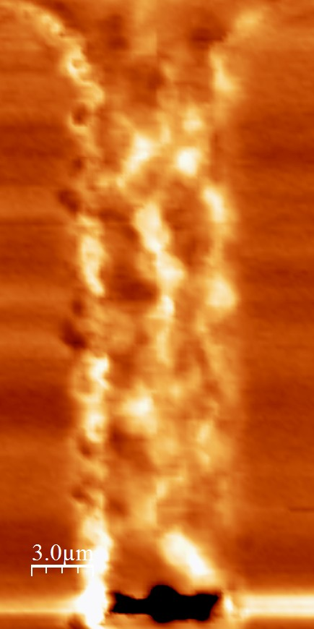
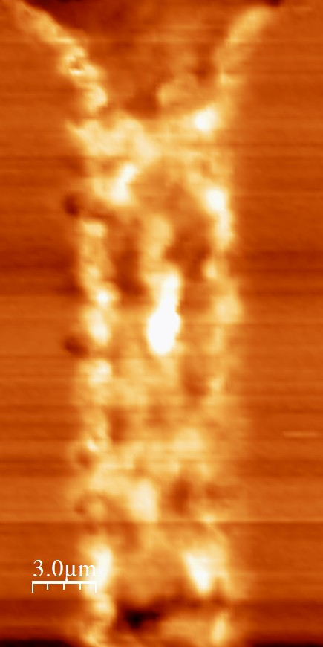
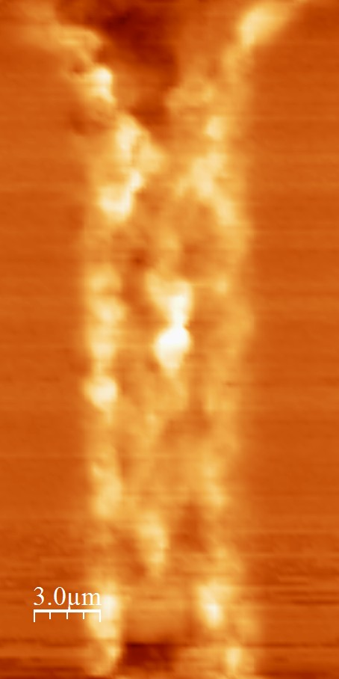
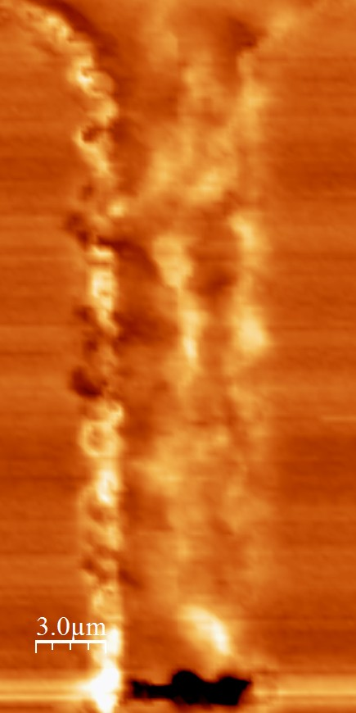
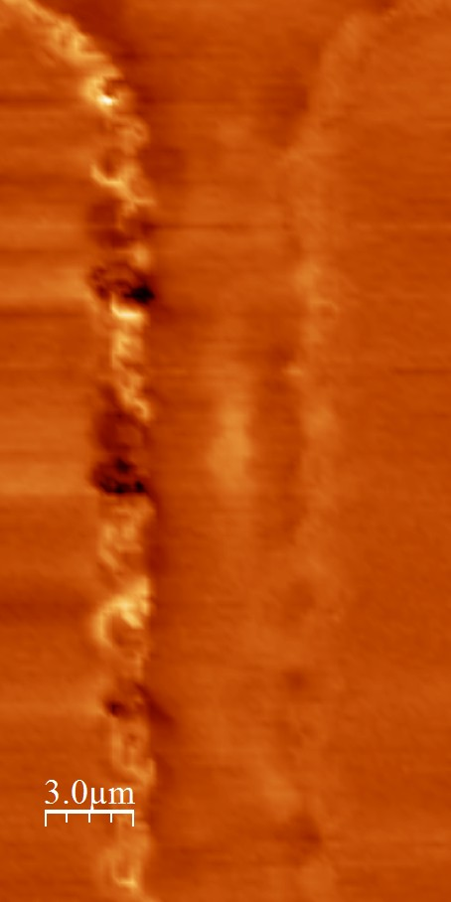









Defomation of incompressible pattern at large current (QHE breakdown)
0.1mV
0.6 $μ$A
1.0 $μ$A
ν=1.05
0.9 $μ$A
1.2 $μ$A
1.5 $μ$A
ν=1.01
1.5 $μ$A
0
1.2$μ$A
2.2 $μ$A
2.5 $μ$A
－0.1mV
ΔV_{x}
Filling dependent pattern
Measured by Taninaka (Tohoku Univ.)
Notes:
Additionally, we address how the incompressible patterns deformed at a large imposed current. At low current, pattern clearly shows nu dependence as shown in previous slide

Slide 32

Incompressible pattern in deep breakdown regime
ν=1.01
2.2 $μ$A
ν =1.00 bulk localized state
Filling dependency of the incompressible pattern is destroyed.
Incompressible/compressible regions coexist
and they are influenced by the potential disorder.

Slide 33
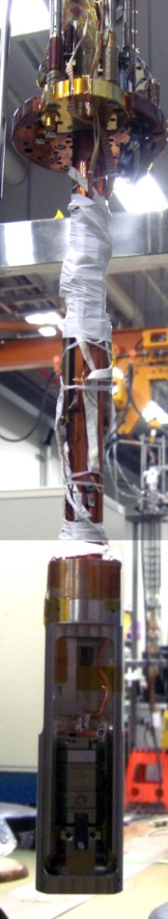
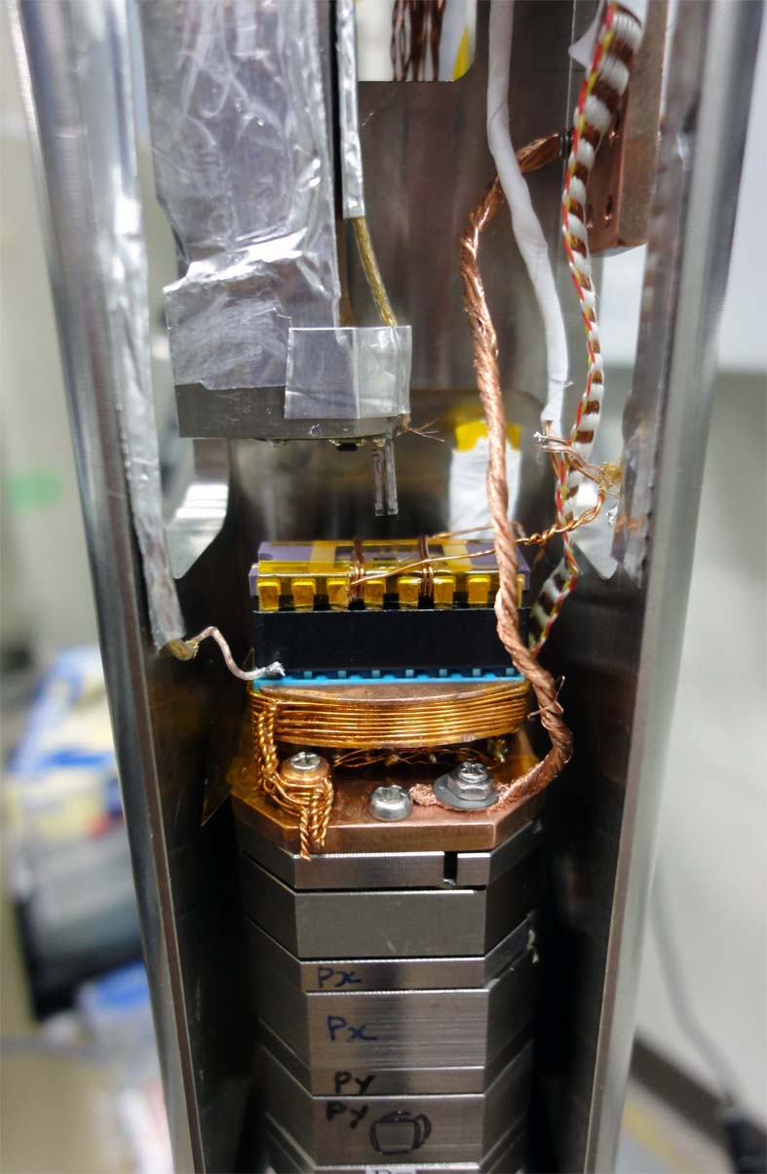
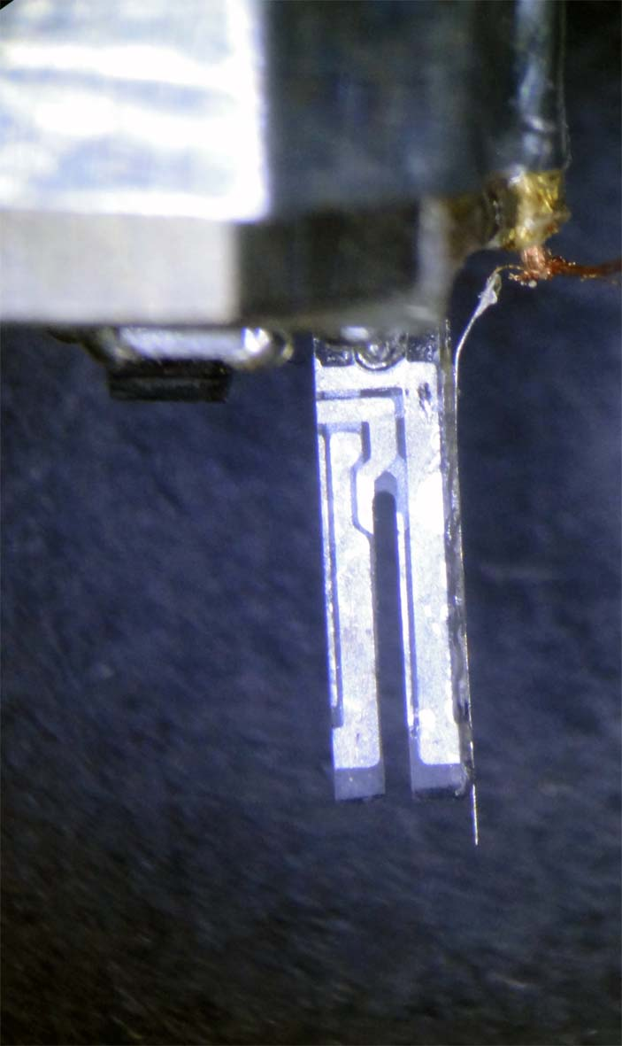
Dilution refrigerator AFM system
Dilution refrigerator unit (Oxford MX100)
B: up to 8 T
T: less than 250 mK
1mm
AFM tip: local gate to apply DC/AC electric field to 2DEG
Atomic force microscope (Attocube AFMIII)

Slide 34
DNP locally induced in incompressible region
Flip-flop process
Electron
spin
Nuclear
spin
LL0
μ_{e}
LL0
C
IC
C

Slide 35
Current dependence of incompressible strip position
2.10
ν =2.18
y (μm)
FWHM
ν =2.32
Distance form edge: Y
ν =2.53
I_{sd} (μA)
To minimize current influence on the incompressible strip, I_{sd} is limited below 4 μA .
Notes:
Since the imposed current could affect position of the incompressible strip, we check the current dependence. To minimizing Isd influence on the incompressible strip patterns, we carefully limit the Isd below 4 A at which position of the strip shows no significant Isd dependence.

Slide 36






Inter LL scattering
Weis, J., & von Klitzing, K., Phil. Trans. R. Soc. A, 369, 3954 (2011).
Innermost incompressible strip
In higher chemical potential side
$$μ_{chemi}$$
$$δ$$
$$I_{t,larger}∝e^{−{(d−δ)}^{2}/l_{B}^{2}}$$
$$I_{t,smaller}∝e^{−{(d+δ)}^{2}/l_{B}^{2}}$$
$$d$$
$$I_{t,larger}−I_{t,smaller}>I_{t}∝e^{−d^{2}/l_{B}^{2}}$$

Slide 37
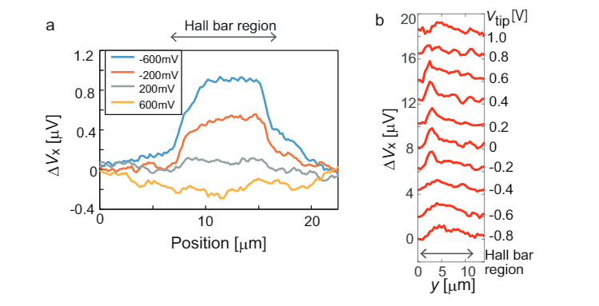

Slide 38
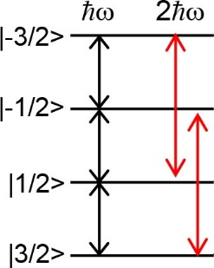

Electric quadrupolar transition induced by RF electric field
Quadrupolar nucleus ⁷⁵As
Nuclear charge distribution
m > ½
RF electric field
-
+
-
Dynamic distortion of electronic environment of nuclei
+
+
Electric quadrupole moment
Magnetic dipole moment
Electric field gradient
$∆m=±2$ transition: Only electric quadrupole mechanism
NR transition
Higher spatial resolution
Bolef et. al., Proceedings of the IEEE 53, 1574 (1965).
Eickhoff et. al., PRB 65 ,125301 (2002).
Tomimatsu et al., AIP Adv. 5, 087156 (2015).
KH et. al., AIP Advances 6, 075024 (2016).
Notes:
Non-spherical positive charge distribution interacts asymmetrically with electric field gradients

Slide 39


Current-direction dependence
$f_{reso}=$ 115.72
$f_{reso}=$ 115.72
I_{x}
I_{x}
|ΔV_{x}| [μV]
B
B
High
Low
High
Hall potential
Hall potential
NER enhancement along an edge where Hall potential is lower

Slide 40
Filling factor dependence of intensity pattern
Bulk
Edge
Local sensitivity of resistive detection?
Pump & probe line mapping with fixing RD sensitivity
Electron
ΔV_{x} [μV]
Bulk
B = 7T
ν = 1.00
ν = 1.10
3 μm
Edge
Hall bar mesa
ν dependent distribution of current induced DNP
submitted

Slide 41
Conventional global NR measurements at ν = 1 quantum Hall breakdown
I_{sd}
B = 8 T
V_{x}
K_{s}
90KHz
0
P_{e}
100%
0
Anomalous tail at low-frequency side;
Muraki, NTT Tech. Rev. 13, 1 (2015).

Slide 42
Knight shift experiments
Local NSR
Spatially averaged NSR
Tip gating NSR
I_{x}
I_{x}
V_{x}
Back gating NSR
V_{x}
Evaluation of maximum Knight shift
100 %
P_{e} = 0 %
90 kHz
K_{s} = 0 kHz
LL0
Fully polarized ν = 1 state; Ks: ~ 90 kHz

Slide 43
DNP locally induced in incompressible region
ν = 1.10
Incompressible strip position in quantum Hall regime
D. B. Chklovskii et al., PRB46, 4026 (1992).
Local filling: ν_{L} = 1; ν = 1.1;
depletion thickness d₀ ~ 364 nm
ν ~ 1.0
ν >1.0
2 μm
3 μm
Electron density
Flip-flop process
Electron
spin
Electrostatic potential
Nuclear
spin
Bulk
Edge
D. B. Chklovskii et al., PRB47, 12605 (1993).
C
IC
C
Visualizing of distribution of dynamic nuclear polarization

Slide 44
Electron
- V_{sd} affects local filling factor?
V₂₋₃
V_{sd} = 83 mV→Δν < 0.04
50 um
V₂₋₃
- Electron spin flip reduces total electron spin polarization?
100 um
V₁₋₂
V₁₋₂
LL0
LL0
E
x

Slide 45

Hyperfine interaction between conductive electron and nuclear spins
e
e
Weak
n
n
n
n
n
n
n
n
n
n
n
n
- Semiconductors; quantum Hall systems
Zeeman energy
$$E_{Z}∝m_{n,e}B$$
Wald et al. PRL 73, 1011 (1994).
KH et al. PRL 88, 176601 (2002).
Kawamura et al. APL 90, 022102 (2007).
electron
nuclear
- Carbon material; ¹³C carbon nanotube
>>
Churchill et al. Nat. Phys. 5, 321 (2009).
Ez
- Topological surface states
2000 times!
J. Tian et al. Science Advances 3, e1602531 (2017)
- Organic molecule; single molecule magnet, organic LED
1% nuclear polarization @ T =1 K, B =100 T
Energy conservation is hard to fulfill
Vincent et al. Nature 488, 357 (2012).
Malissa et al. Science 345, 1487 (2014).
Notes:
Interaction between conductive electron and nuclear spin is normally very weak since Zeeman energy of nuclear is 2000 times less than electron. As a result, to obtain 1% nuclear polarization at 1K we need 100T. Even though hyperfine interaction can transfer angular momentum from electron to nuclear, energy conservation is hard to fulfill. Consequently, it is difficult to polarize nuclear spin and conducutive transport is not affected by nuclear spin.
On the other hand, it has been found that toransport is largely affected by nuclear spins in wide variety of the systems or matterials.

Slide 46
Quadropole Interaction
Transition probabilities :
B
z, [001]
y, [010]
: Transition probability from to
x, [100]
: Electric field gradient component
GaAs 2DEG
RF electric field
Dynamic distortion of electronic environment of nuclei
Lateral electric field
Vertical electric field
Electric field gradient
[ R. V. Pound, PR (1950)]
[ R. I. Bolef et al., PR (1959)]
NSR transition
[ E. Brun. Bolef et al., PR (1963)]

