Slide 1


Rare-earth doped
Topological Insulators
4. September, 2018
Jinsu Kim
Myung-Hwa Jung
Department of Physics
Sogang University, Seoul, Korea

Slide 2
Contents
3D topological insulators (TIs)
Nonmagnetic doping effect
Magnetic doping effect
Rare-earth doped TIs → Antiferromagnetic
Gd-doped Bi₂Se₃
Gd-doped Bi₂Te₃
→ Possible Weyl semimetal
(Magnetic dopants)
 Gd doping effect
− Vacuum annealing effect
− Tuning effect of E_{F}

Slide 3
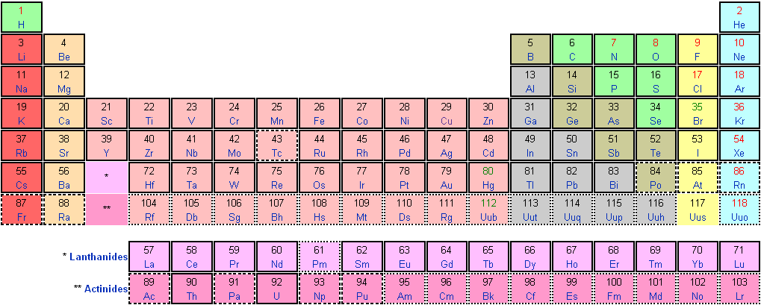
Periodic table
3D Topological insulators (TIs)
A₂B₃ (A = Sb or Bi & B = Se or Te)
: Sb₂Se₃, Sb₂Te₃, Bi₂Se₃, Bi₂Te₃
ex) Bi₂Se₃
: Insulator
Bi : 6s²6p³ → Bi³⁺ : 6s²6p⁰ (or Bi³⁻ : 6s²6p⁶)
Se : 4s²4p⁴ → Se²⁻ : 4s²4p⁶

Slide 4
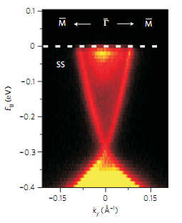
Fermi level issue
• Exotic topological surface properties → E_{F} at the Dirac point
But, difficult to locate the Fermi level at the Dirac point
difficult to distinguish the surface state from the bulk band
E
E_{F}
BCB
SS
Δ
Dirac point
E_{F}
BVB
k
ARPES
Bulk electron is measured…
(n_{3D}~10¹⁹/cm³ vs. n_{2D}~10¹²/cm²)

Slide 5
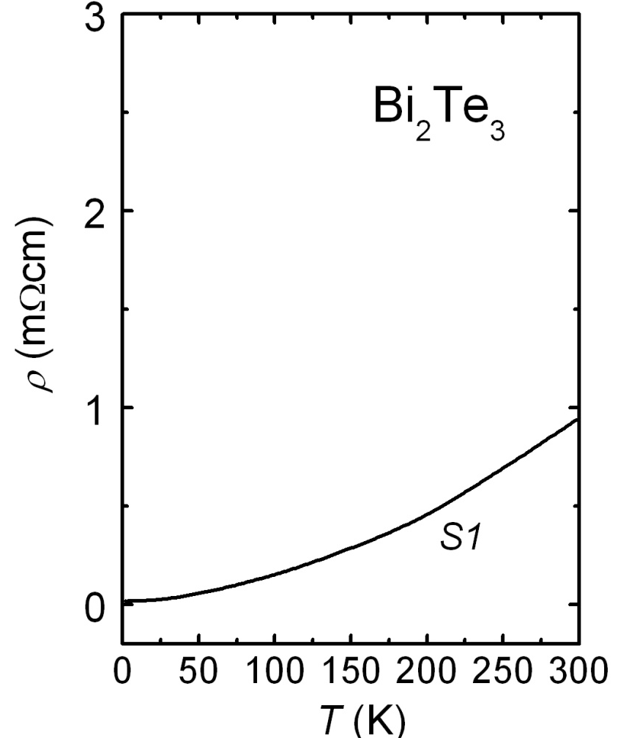
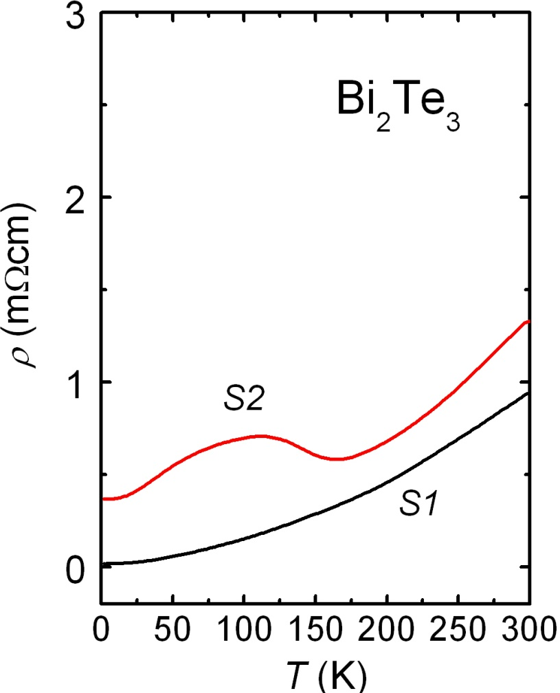
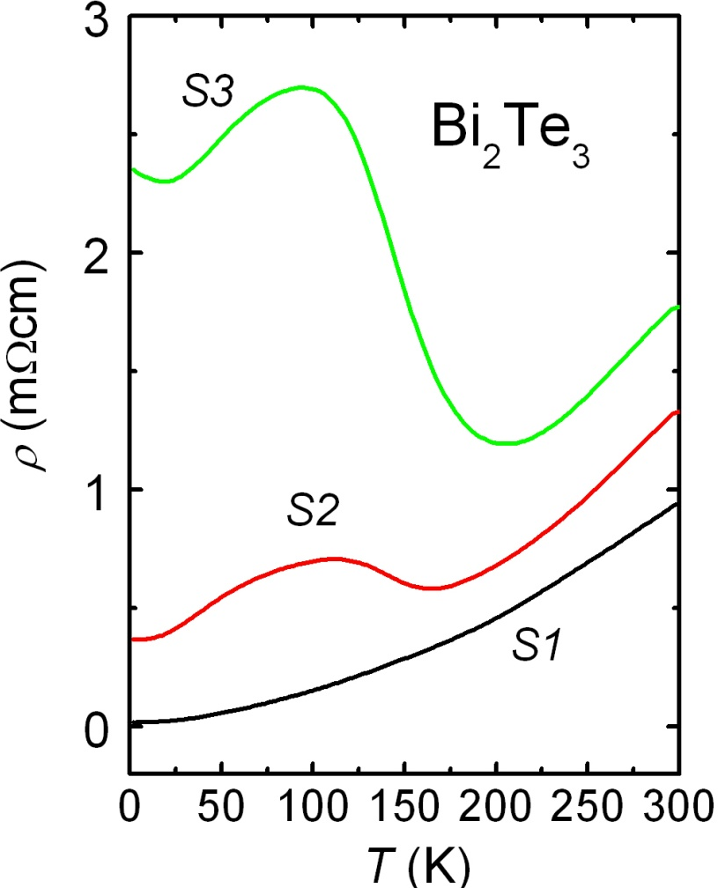
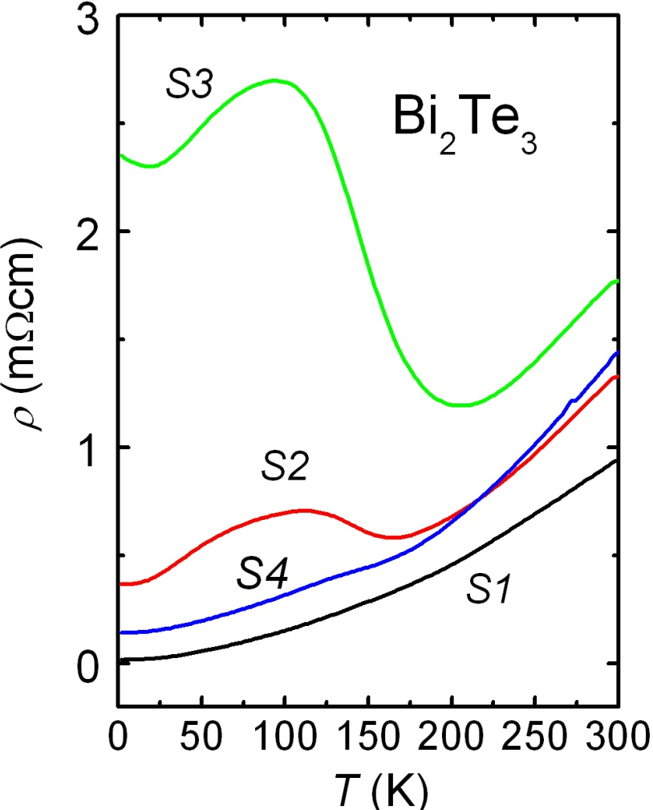
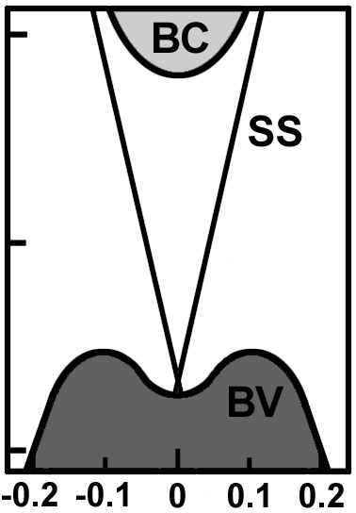
E_{F} tuning by annealing (Bi₂Te_{3+δ})
Antisite defects
Te_{Bi}
(n-type)
S4
E_{B} (eV)
S3
S2
S1
E_{F}
Bi_{Te}
(p-type)

k_{x} (Å⁻¹)
Fine tuning of Bi₂Te_{3+} (by Te annealing)

Slide 6



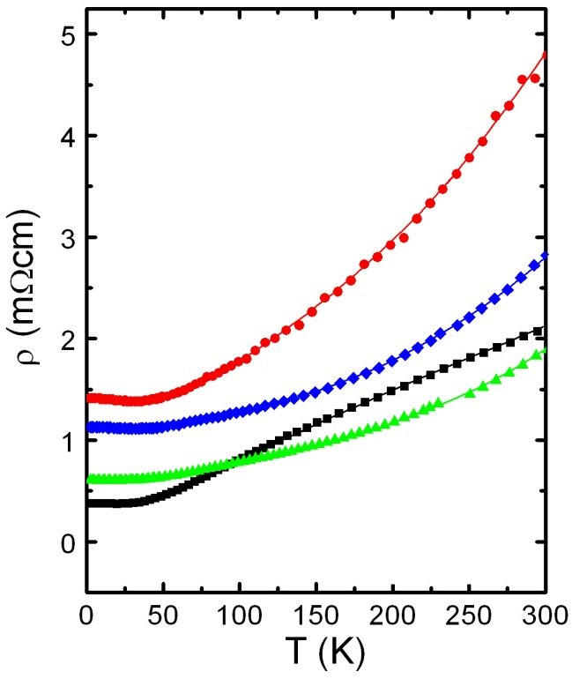
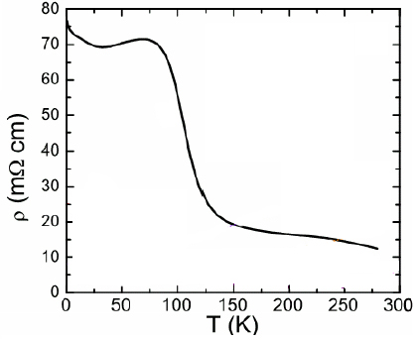
Fine tuning of E_{F} by doping (Bi_{2-x}Ca_{x}Se₃)
x = 0
x = 0.025
x > 0.01
Se vacancies
(n-type)
Ca²⁺ instead of Bi³⁺ → (p-type)
Metallic
Metallic
Non-metallic
PRL 103, 246601 (2009)

Slide 7
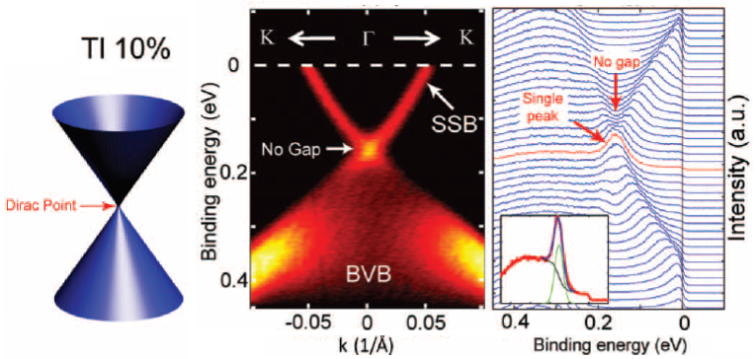
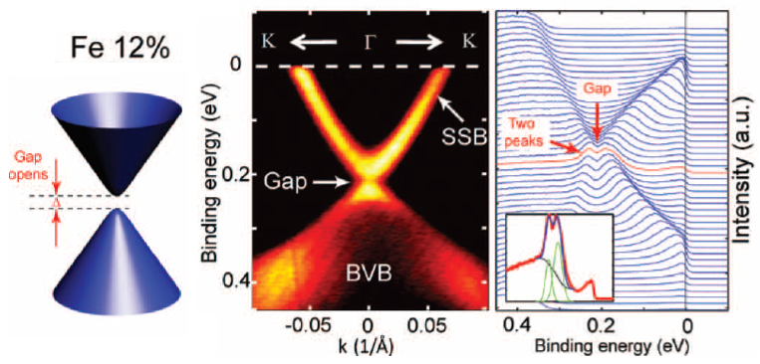
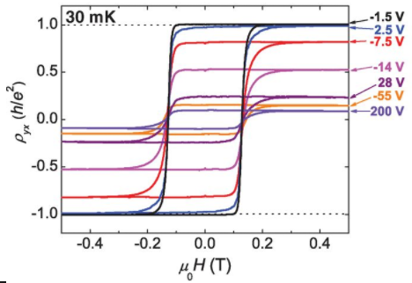
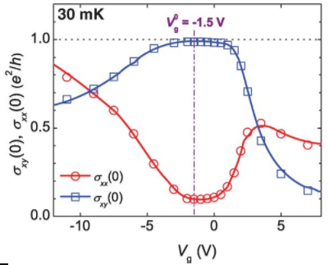
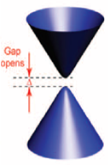
Magnetic doping (Bi_{2-x}Tr_{x}Se₃)
nonmagnetic
magnetic
No gap opening (nonmagnetic Tl)
Gap opening (magnetic Fe)
FM → Spin-related applications
Quantum phenomena
Science 329, 5992 (2010)
Cr_{x}(Bi,Sb)_{2-x}Te₃
FM
QAHE
E_{F}
Science 340, 167 (2013)

Slide 8
Periodic table
Bi³⁺
Tr : 4s²3d^{n} → Tr²⁺ : 4s⁰3d^{n}
Transition metals (Tr²⁺)
Bi_{2-x}Tr_{x}Te₃: Trivial topological insulator
Tr²⁺ ( 4s⁰4p⁰3d^{n} ) → Doping of charge carriers (hole doping)
→ Tuning magnetism (only FM ordering)

Slide 9
Periodic table
Bi³⁺
Rare-earth metals (Ln³⁺)
Gd : 6s²4f⁸ → Gd³⁺ : 6s⁰4f⁷ (~7μ_{B})
Bi_{2-x}Ln_{x}Te₃: Another type of magnetic TIs?
Ln³⁺ ( 5s²5p⁶4f^{n} ) → No doping of charge carriers?
→ Tuning only magnetism (AFM ordering?)

Slide 10
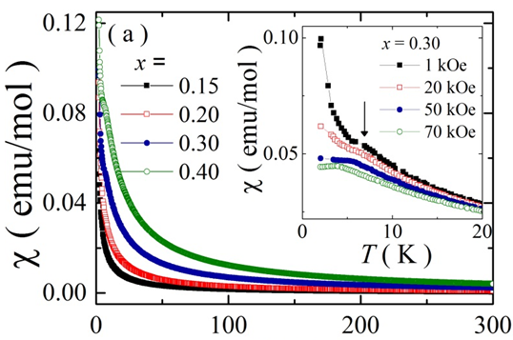
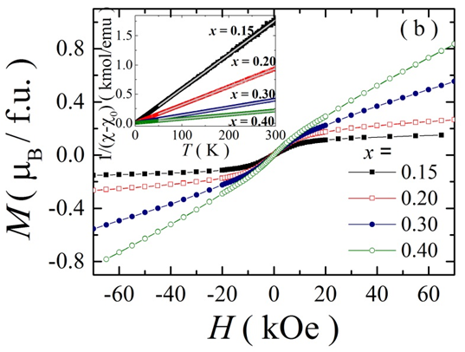
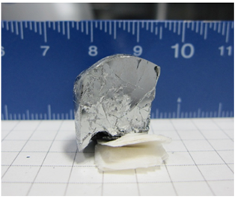
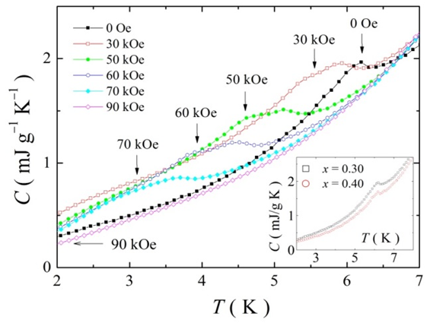
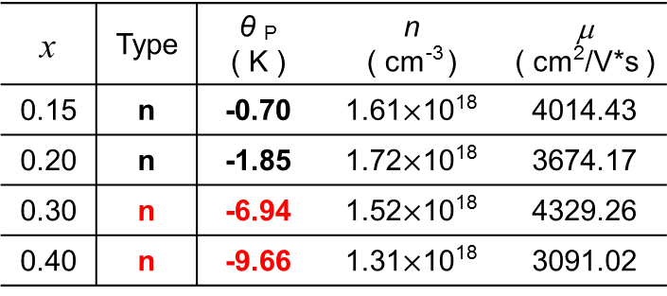
Antiferromagnetism in Gd_{x}Bi_{2-x}Se₃
x | Type | n ( cm⁻³ ) | θ _{P} ( K ) | T_{N} ( K )
0.15 | n |  | -0.70 | -
0.20 | n |  | -1.85 | -
0.30 | n |  | -6.83 | 6.2
0.40 | n |  | -7.98 | 7.0
PM
AFM
→ Weak antiferromagnetic signal at x  0.3

Slide 11
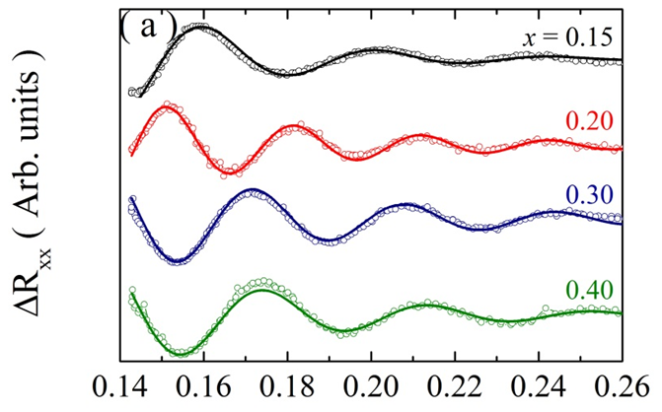
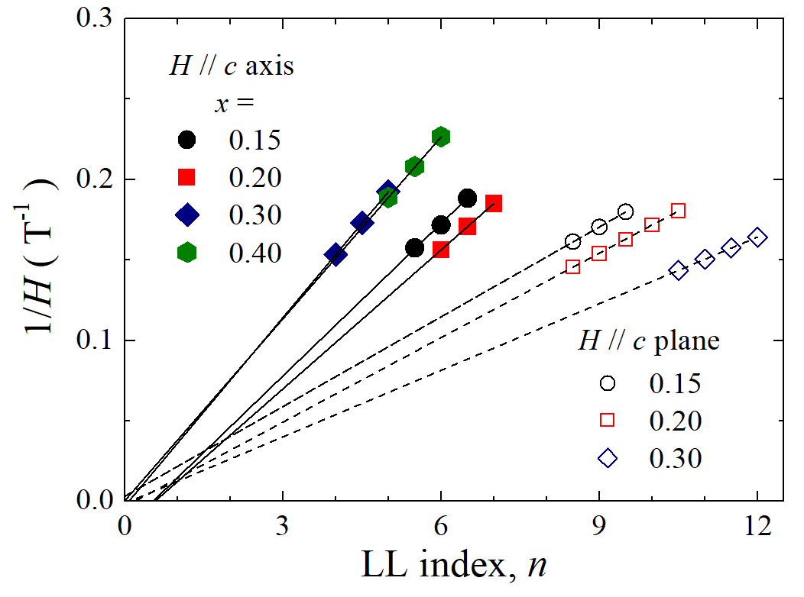
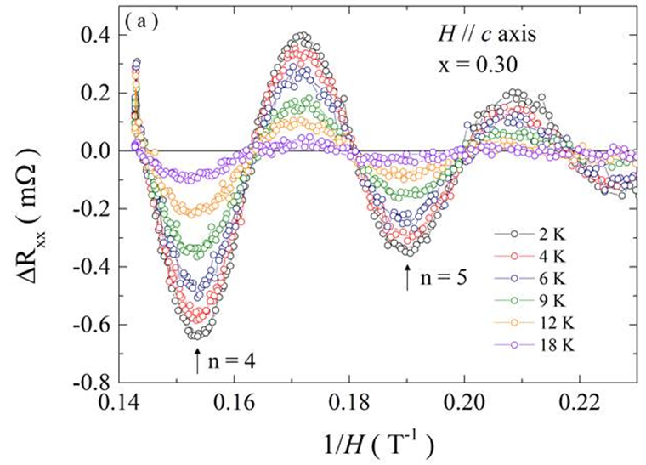
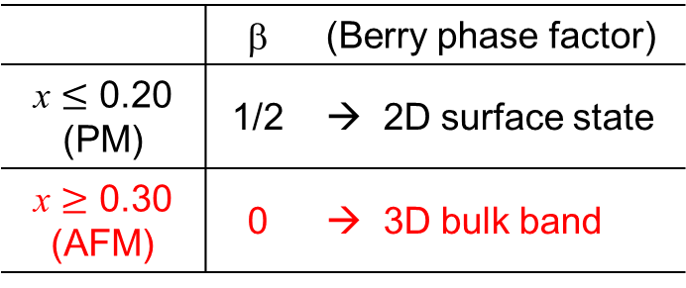
Competing TSS with AFM in Gd_{x}Bi_{2-x}Se₃
Landau level fan diagram
1/2
 | β | (Berry phase factor)
 | 1/2 | → 2D surface state
 | 0 | → 3D bulk band

Slide 12
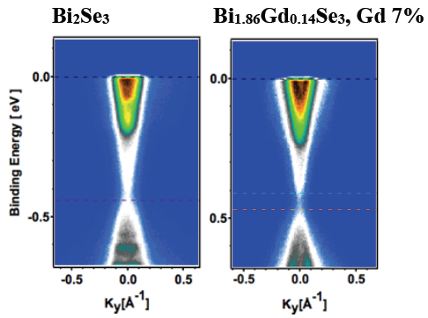
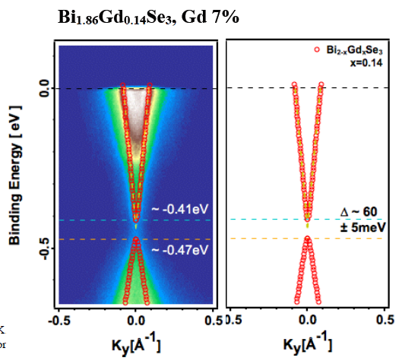
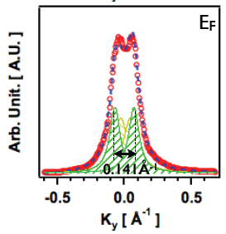
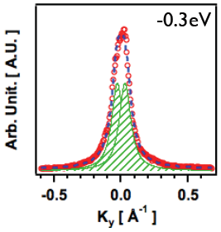
Gap opening in Gd_{x}Bi_{2-x}Se₃
No gap
Gap
Bi_{0.85}Gd_{0.14}Se₃
Δ ~ 60 meV
AFM → TRS breaking
→ Gap opening

Slide 13
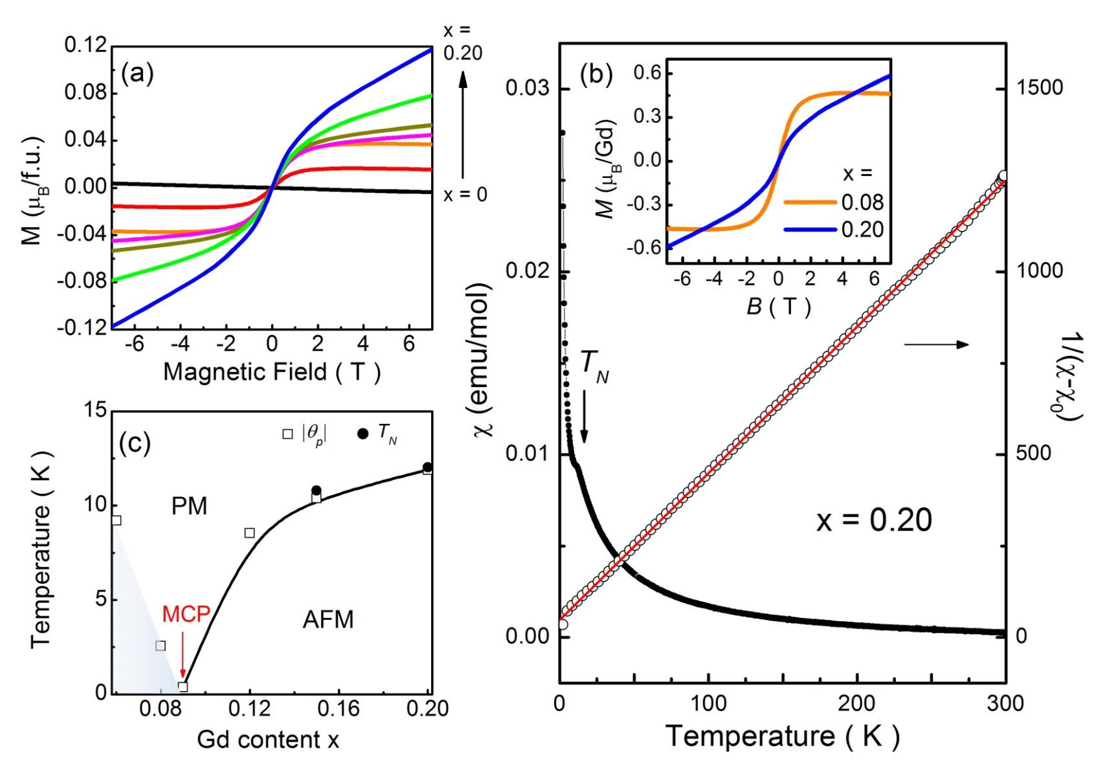
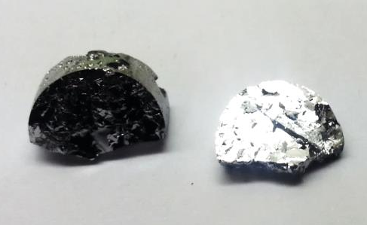
Phase transition in Gd_{x}Bi_{2-x}Te₃
= 12 K
x < 0.09: PM (weak FM) → x > 0.09, AFM

Slide 14
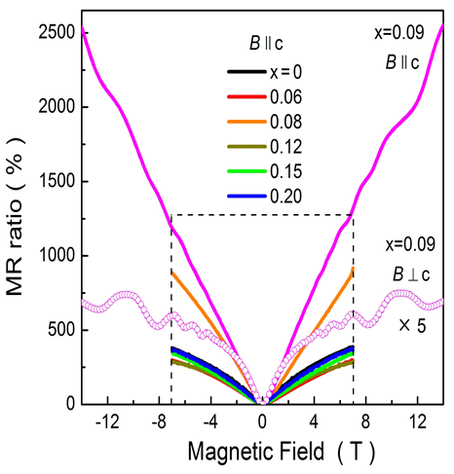
2D Fermi surface at x = 0.09
x = 0.09
1/2
At x = 0.09 (MCP),
= 1/2 for B//c
→ 2D TSS
x < 0.09: PM (weak FM) → x > 0.09, AFM

Slide 15
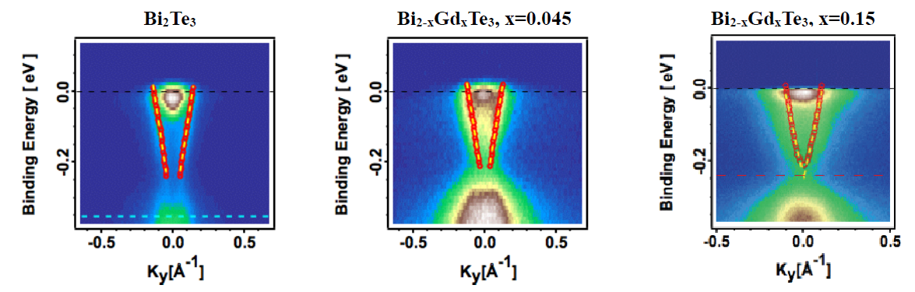
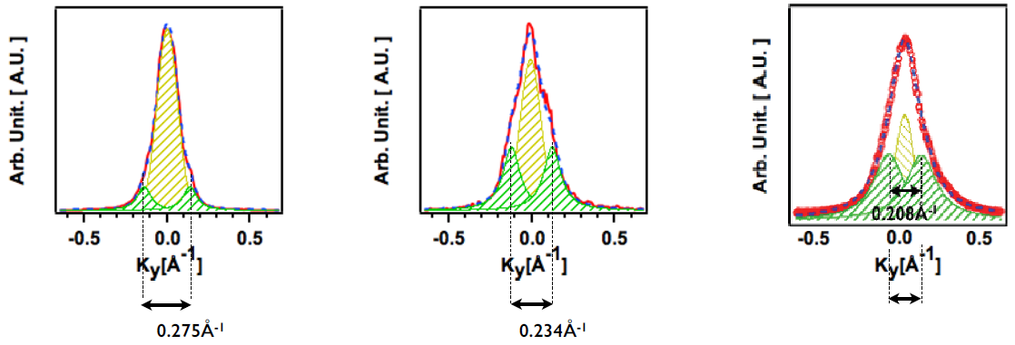
Band structure of Gd_{x}Bi_{2-x}Te₃
, x=0
NM
PM
AFM
0.208Å⁻¹

Slide 16
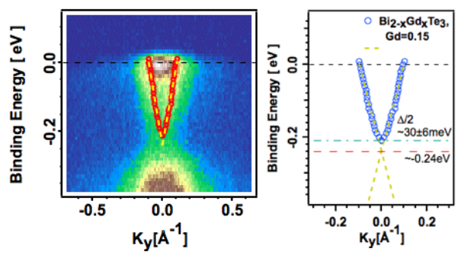
Gap scale by magnetic dopant
Gd 15%
Bi_{0.85}Gd_{0.15}Te₃
Δ ~ 60 meV
cf) Bi_{0.86}Gd_{0.14}Se₃
 ~ 60 meV

Slide 17
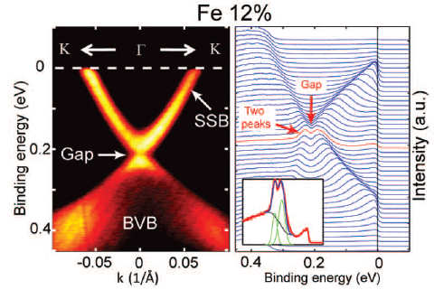

Gap scale by magnetic dopant
Gd 15%
24%
Science 329, 5992 (2010)
Our results
Bi_{0.85}Gd_{0.15}Te₃
Δ ~ 60 meV
Bi_{0.76}Fe_{0.24}Te₃
Δ ~ 44 meV
Gd³⁺ ~ 7_{B}
Fe²⁺ ~ 4_{B}

Slide 18
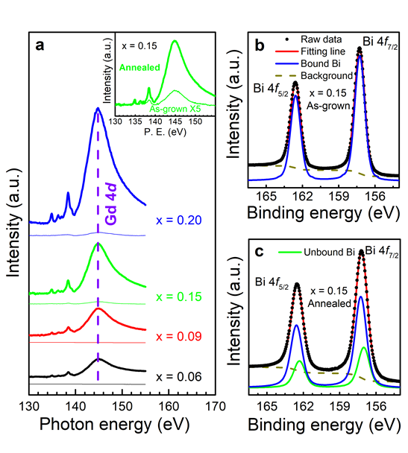
Annealing effect in Gd_{x}Bi_{2-x}Te₃
Near edge x-ray absorption fine structure (NEXAFS) & XPS
: sensitive to surface
Gd peak increases with x
Annealed at 250ºC for 2 h
under UHV (1 x 10⁻¹⁰ Torr)
After annealing,
Gd peak ↑
→ more populated Gd
Before annealing,
Fitted only with bound Bi
After annealing,
Bound Bi ↓ + Unbound Bi
→ Bi out-diffusion
→ metallic Bi at surface
Annealed
As-grown

Slide 19
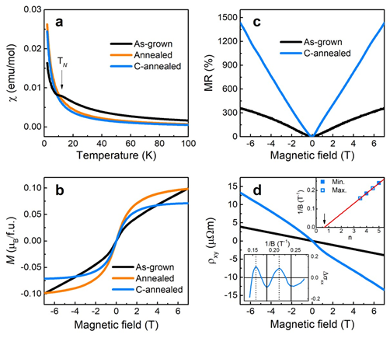
Restored TSS after annealing
Before annealing,
( x = 0.15 )
T_{N} = 11.5 K
MR = 360%
β = 0
After annealing,
T_{N} disappears
MR = 1400%
β = 1/2
Two-band Hall
→ Restored TSS
C-W fit
→ x = 0.10 (MCP)

Slide 20
Gap closing after annealing
Bi₂Te₃
Gd_{0.15}Bi_{1.85}Te₃
Pristine
As-grown
Annealed
No gap
Gap opening
Gap closing
(NM)
(AFM)
(PM)

Slide 21
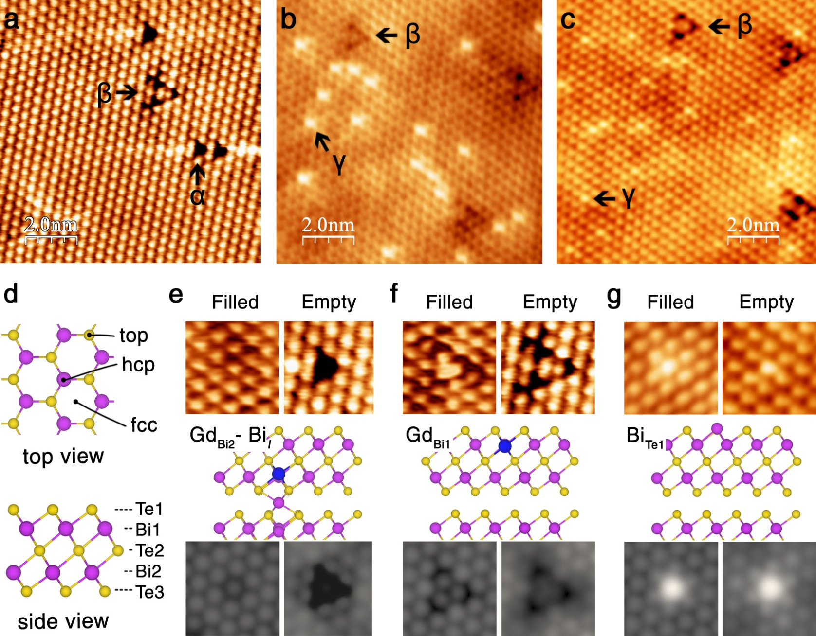
Microscopic analysis of annealing effect
Before
After
After
Pristine
A → Te_{Bi1}
B → Te_{Bi2}
C → V_{Bi2}
Gd doping
 → Gd_{Bi2}−Bi_{i}
 → Gd_{Bi1}
After annealing
 disappears.
 increases.
 appears.
→ Bi_{Te1}
α
β
γ
Quintuple
layer
of Bi₂Te₃

Slide 22
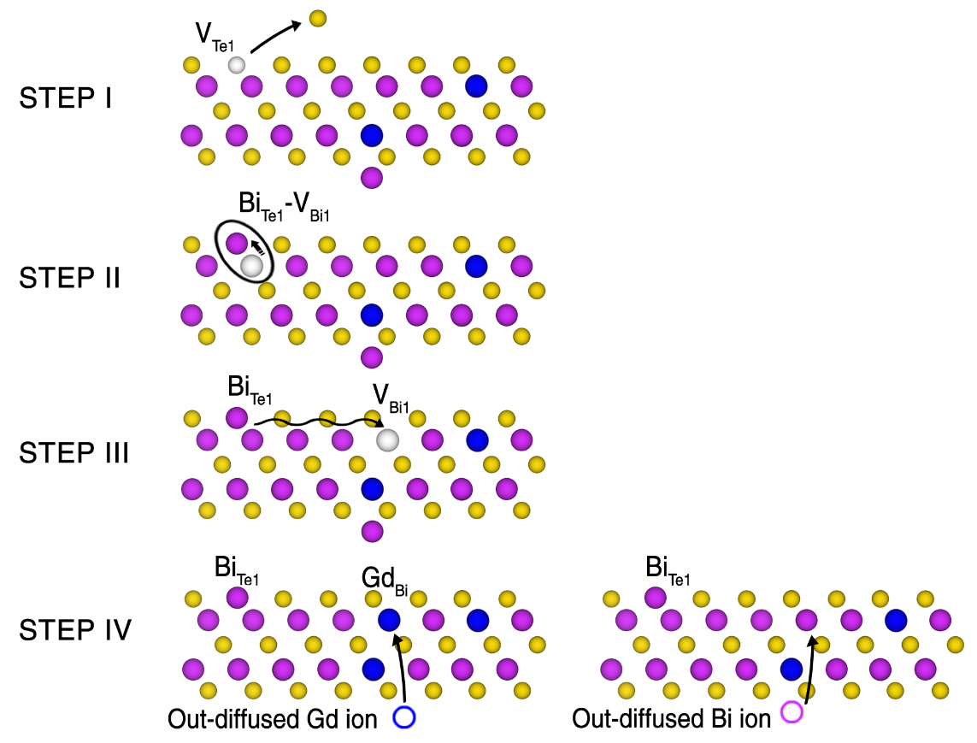
Schematic picture upon annealing
Evaporation of top surface Te
→ V_{Te1} (volatile Te)
Migration of adjacent Bi
→ Bi_{Te1}V_{Bi1} pairs

Isolated Bi_{Te1} →  defect Liberation of V_{Bi1}

1
: Occupied by out-diffused Gd
→ Gd_{Bi1} ( defect), Gd_{Bi2} ( defect)
: increment : removal

Gd_{Bi2}
Restored TSS

Slide 23

Tuning effect in Gd_{x}Bi_{2-x}Te_{3-y}Se_{y} (y=0.2)
(x = 0.1)
LMR
TMR
T_{N} = 9.2 K
LMR
LMR
y = 0.2 | Carrier type | n (cm⁻³) | μ (cm²/Vs)
2 K | p | 5.22 × 10¹⁸ | 7120
300 K | p | 9.93 × 10¹⁸ | 178
cf) y = 0 ; T_{N} = 9.2 K, p = 29.410¹⁸ cm⁻³
E_{F}
y =0

Slide 24
Tuning effect in Gd_{x}Bi_{2-x}Te_{3-y}Se_{y} (y=0.6)
(x = 0.1)
TMR
LMR
LMR
T_{N} = 9.1 K
y = 0.6 | Carrier type | n (cm⁻³) | μ (cm²/Vs)
2 K | n | 0.58 × 10¹⁸ | 211
300 K | p | 7.70 × 10¹⁸ | 89
y =0.6
E_{F}
cf) y = 0.2 ; T_{N} = 9.2 K, p = 5.2210¹⁸ cm⁻³
y =0.2
y =0

Slide 25
Tuning effect in Gd_{x}Bi_{2-x}Te_{3-y}Se_{y} (y=1.5)
(x = 0.1)
TMR
LMR
LMR
T_{N} = 9.0 K
TMR
y = 1.5 | Carrier type | n (cm⁻³) | μ (cm²/Vs)
2 K | n | 14.1 × 10¹⁸ | 894
300 K | n | 14.5 × 10¹⁸ | 59
y =1.5
E_{F}
LMR
y =0.6
cf) y = 0.6 ; T_{N} = 9.1 K, n = 0.5810¹⁸ cm⁻³
y =0.2
y =0

Slide 26
Summary for tuning effect by Se
T_{N} = 9.0 ~ 9.2K
y | T (K) | ρ (mΩcm) | Carrier type | n (10¹⁸cm⁻³) | μ (cm²/Vs)
1.5 | 2 K | 6.6 | n | 14.1 | 894
 | 300 K | 7.3 |  | 14.5 | 59.4
1.0 | 3 K | 42 | n | 5.36 | 27.5
 | 300 K | 17 |  | 3.31 | 111
0.7 | 2 K | 3800 | n | 0.42 | 3.91
 | 300 K | 25 | p | 5.57 | 45.0
0.6 | 2 K | 57 | n | 0.58 | 211
 | 300 K | 9.1 | p | 7.70 | 88.9
0.5 | 3 K | 7.8 | p | 0.75 | 1060
 | 300 K | 1.0 |  | 4.53 | 136
0.2 | 2 K | 0.2 | p | 5.22 | 7120
 | 300 K | 3.5 |  | 9.93 | 178
0.1 | 2 K | 0.06 | p | 13.3 | 7850
 | 300 K | 1.3 |  | 22.1 | 215
n-type
Crossover point y ~ 0.7
p-type

Slide 27
Evolution of electrical transport
y = 0.6
y = 1.5
n-type
y = 0.2
y = 1.0
Crossover point y ~ 0.7
y = 0.1
p-type
y = 0.7

Slide 28
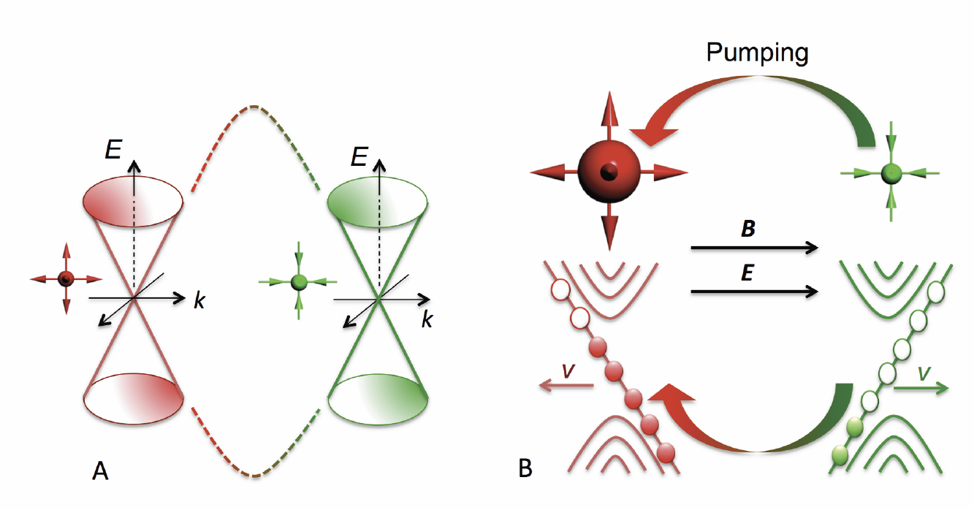
Possible Weyl state
Inversion symmetry breaking
E·B term → Charge pumping
TaAs, NbAs, NbP, TaP
Time reversal symmetry breaking
ZrTe₅, Na₃Bi, Cd₃As₂, Bi_{1-x}Sb_{x},
Y₂Ir₂O₇, HgCr₂Se₄, Hg_{1-x-y}Cd_{x}Mn_{y}Te
→ Negative LMR
Gd_{x}Bi_{2-x}Te_{3-x}Se_{y}
  ● Gd (antiferromagnetic ordering)
  : acts as effective magnetic field
  → Zeeman splitting
  → Reduction of bulk band gap
  ● Se (n-type carrier doping)
  : tunes the Fermi level
  → Weyl point at E_{F}
WAL

Slide 29
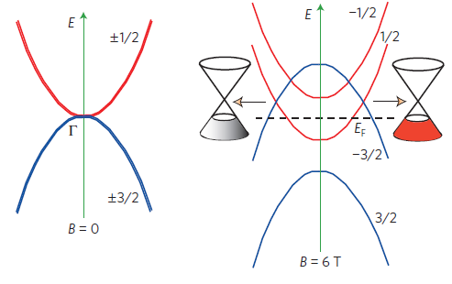
New Weyl materials
Inversion symmetry breaking
Magnetic field (magnetic order)
TaAs, NbAs, NbP, TaP
Time reversal symmetry breaking
ZrTe₅, Na₃Bi, Cd₃As₂, Bi_{1-x}Sb_{x},
Y₂Ir₂O₇, HgCr₂Se₄, Hg_{1-x-y}Cd_{x}Mn_{y}Te
Gd_{x}Bi_{2-x}Te_{3-x}Se_{y}
E
E
E
E
E
E
  ● Gd (antiferromagnetic ordering)
  : acts as effective magnetic field
  → Zeeman splitting
  → Reduction of bulk band gap
  ● Se (n-type carrier doping)
  : tunes the Fermi level
  → Weyl point at E_{F}
E
E_{F}
E_{F}
E_{F}
E_{F}
E_{F}
E_{F}
E_{F}
x = x₃, y = y₁
x = x₃, y = y₂
x = x₃, y = y₃
x = x₁
x = x₂
x = x₃
x = 0
Zero-gap material
Magnetic dopants
Fermi level tuning
x = x₃, y = y₂
New Weyl material

Slide 30
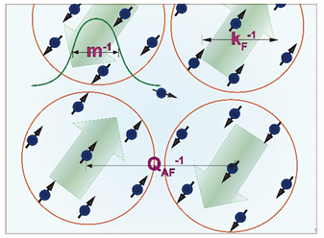
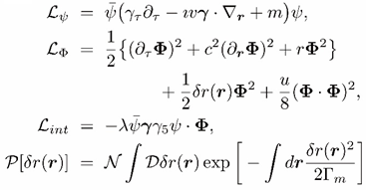

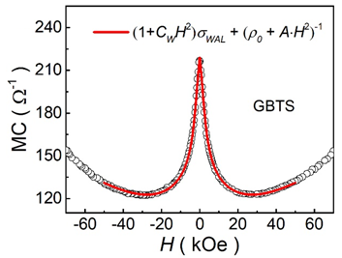
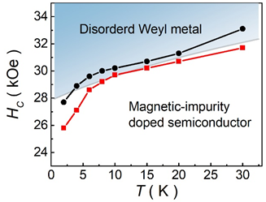
Weyl metal state in Gd_{x}Bi_{2-x}Te_{3-y}Se_{y}
Renormalization group analysis
Effective field theory

Slide 31
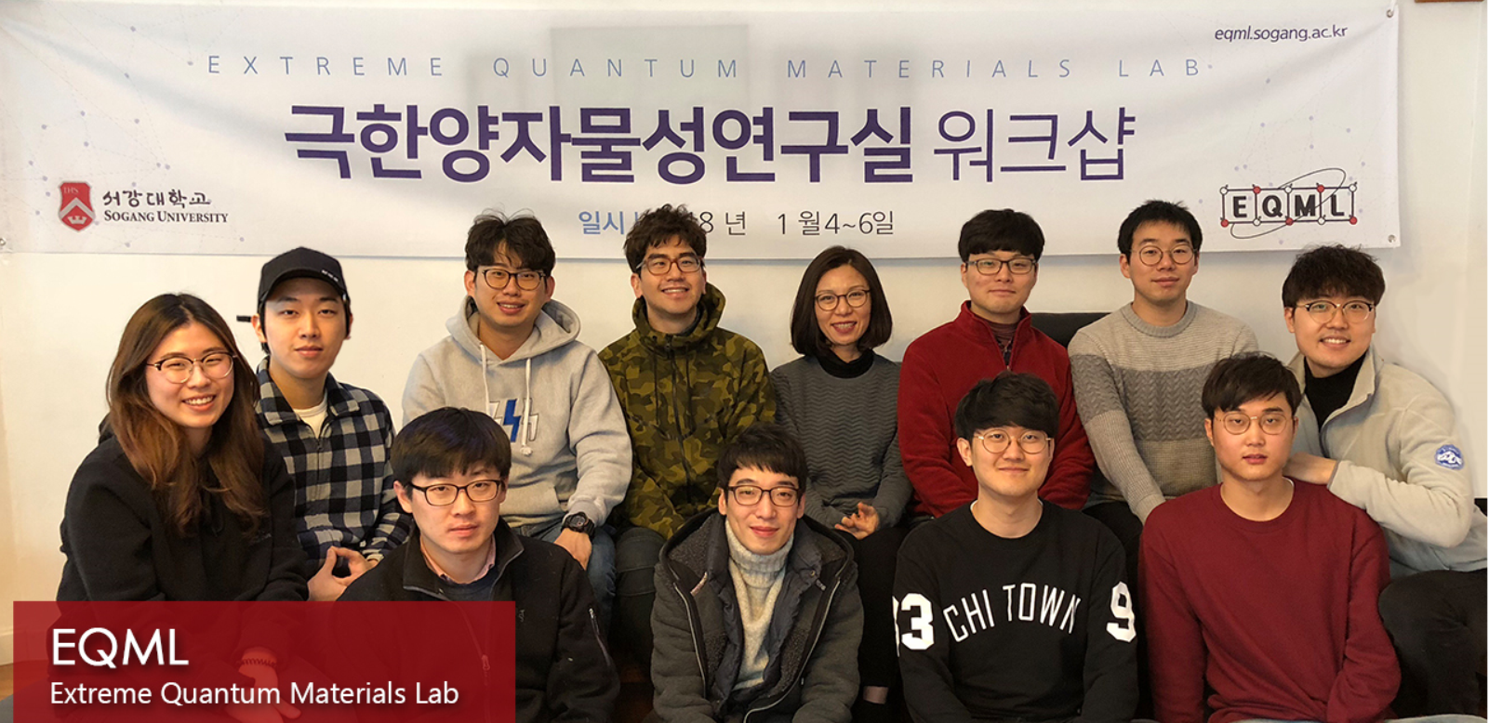
Acknowledgements
Extreme Quantum Materials Laboratory (EQML)
http://eqml.sogang.ac.kr/ssmc/
e-mail: mhjung@sogang.ac.kr
TI and Weyl
bulk group
Magnetic thin
film group
Thank you

